Slide 1
Bond Information Meeting
October 3rd@7:30pm elementary school
October 9th@7:30pm Jr/Sr High school
Notes:
Daryl

Slide 2
Meeting Objectives
Welcome/Introductions
Process
Facility Needs and Solutions
Financial Information
Important Questions
Public Q&A
Notes:
Daryl

Slide 3
Process
timeline

Slide 4
Facility Needs Process and Timeline
Oct 9, 2020 RPS requests proposals for CTE building design
Mar 3, 2021 RPS signs contract with Fakler Architects for CTE design
Apr 16, 2021 CTE building design begins
February 4, 2022 CTE building design completed
Mar 17, 2022 CTE building bids due. Lone bid received: $3,952,100
Nov 2, 2023 Architect and Construction Manager tour RPS
Jan 3, 2024 Audit of facility gets underway, including structural review and needs assessment discussions with staff & maintenance
January 30, 2024 Abatement company site visit
February 26, 2024 Steering Committee Kickoff. Members review final Facility Audit; tour areas under consideration for bond; review needs list to date.
April 4, 2024
Small groups brainstorm facility needs; compile into overall needs list. Discuss process, Facility Audit Summary, Priority Activity & Survey
April 18, 2024 Steering committee performs final needs ranking; reviews financial impact & CTE bldg cost estimates; tours HS hall by PA gym & Elementary
Early June 2024: Fakler Architects sends conceptual drawings and narrative to BD Construction for cost estimating
Mid-June 2024
BD Construction estimates costs and performs construction review
June 25, 2024 Steering committee discusses, estimated costs and preliminary tax impact.
August 1, 2024 Public Information Meeting and School Tours
August 12, 2024 BOE Agenda includes Steering Committee recommendation to approve project and budget. Bond election resolution.
Sept / Oct 2024 Bond education process including community presentations, tours, mailers, website, social media, community events, etc.
November 5, 2024 Election Day

Slide 5
Facility Needs

Slide 6
New Career and Technical Education (CTE) Building
MS/HS
Roof repairs
AC in main gym
Elementary
HVAC
Lighting/additional outlets
Fire sprinklers/alarms
Windows
Restrooms
Secure entry
Serving kitchen
Notes:
Daryl

Slide 7
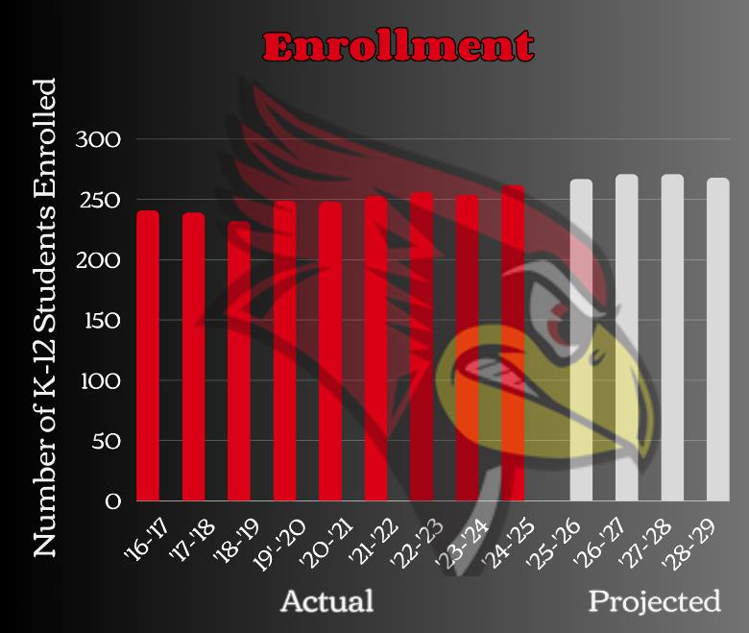
Enrollment Trends
5-year enrollment history
24-25 262
23-24 254
22-23 256
21-22 253
20-21 248
10-year enrollment average = 250
Next four years projected average = 269 (using birth to 5 census data)
Notes:
Daryl

Slide 8
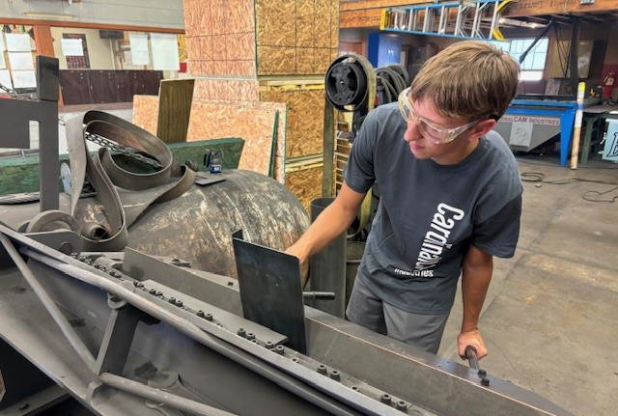
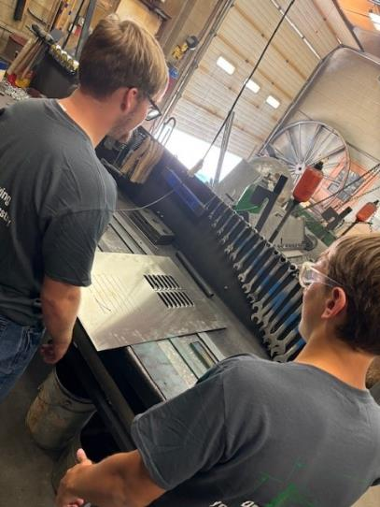
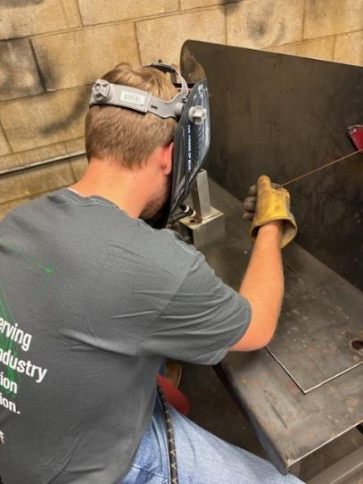
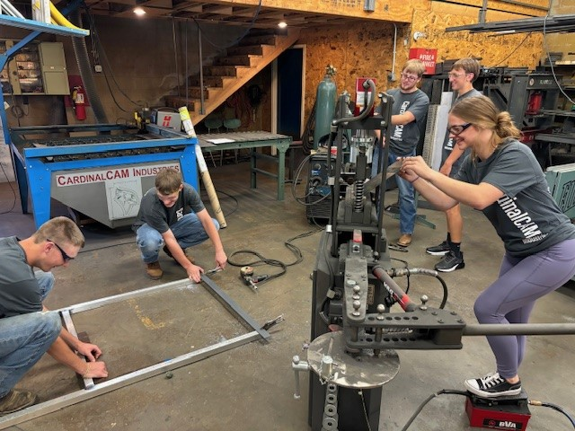
CTE Building
Notes:
Brandi discuss improvements needed at this building. Could also focus on Art challenges so that it can come together during project solution portion of meeting.

Slide 9
Number of Students who Attended Classes in the Ag Building
Notes:
Brandi. This is where we are at now. These numbers will be higher in the new building. Compare to 104 enrolled.

Slide 10
Career and Technical Education Building
Notes:
Brandi discuss the reason for this investment and impact on students and community. H3 jobs. Did you know that 1 in 4 jobs in Nebraska are in agriculture?
Why we are investing in this type of building.

Slide 11
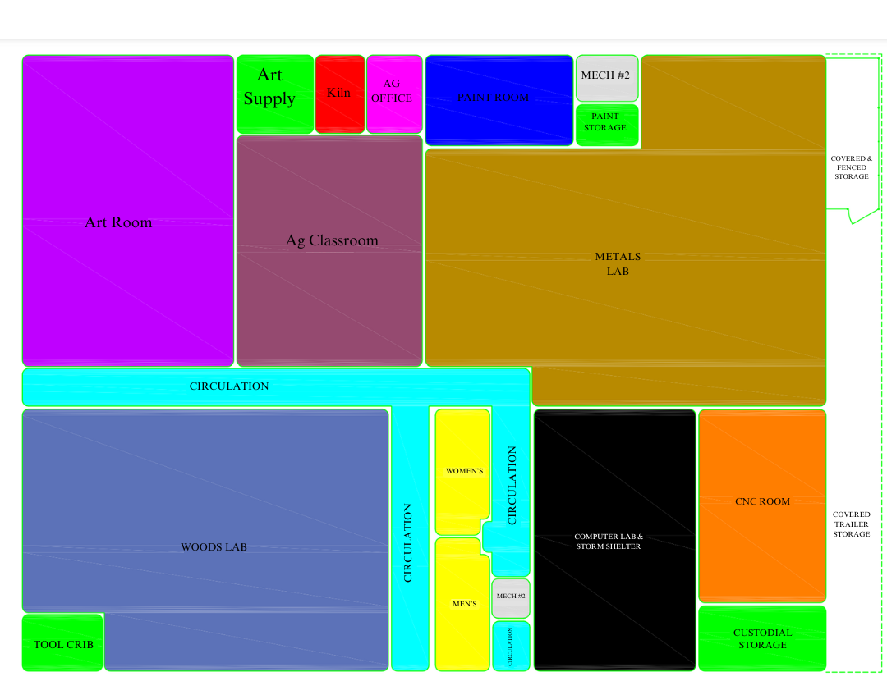
Career and Technical Education Building
Notes:
Brandi: Talk about the layout, educational spaces, storm shelter, and number of students that ‘do’ and ‘could’ use this space. Lay the foundation for this ‘much needed classroom addition’. What happens to existing art room? Can share computer lab, woods, metals space. Opens space in the high school that could be used for different college programs, future expansion of electives, future curriculum demands.

Slide 12
Courses offered in the new Career and Technical Education Building
Animal Science/Large Animal Management
Plant & Soil Science
Welding
Fine Woodworking
AgriScience
Agricultural Exploration
Drafting
Building Construction
Metals Fabrication
Agricultural Business
Art Classes
Cardinal Cam
Cardinal Creative
Notes:
Brandi.

Slide 13
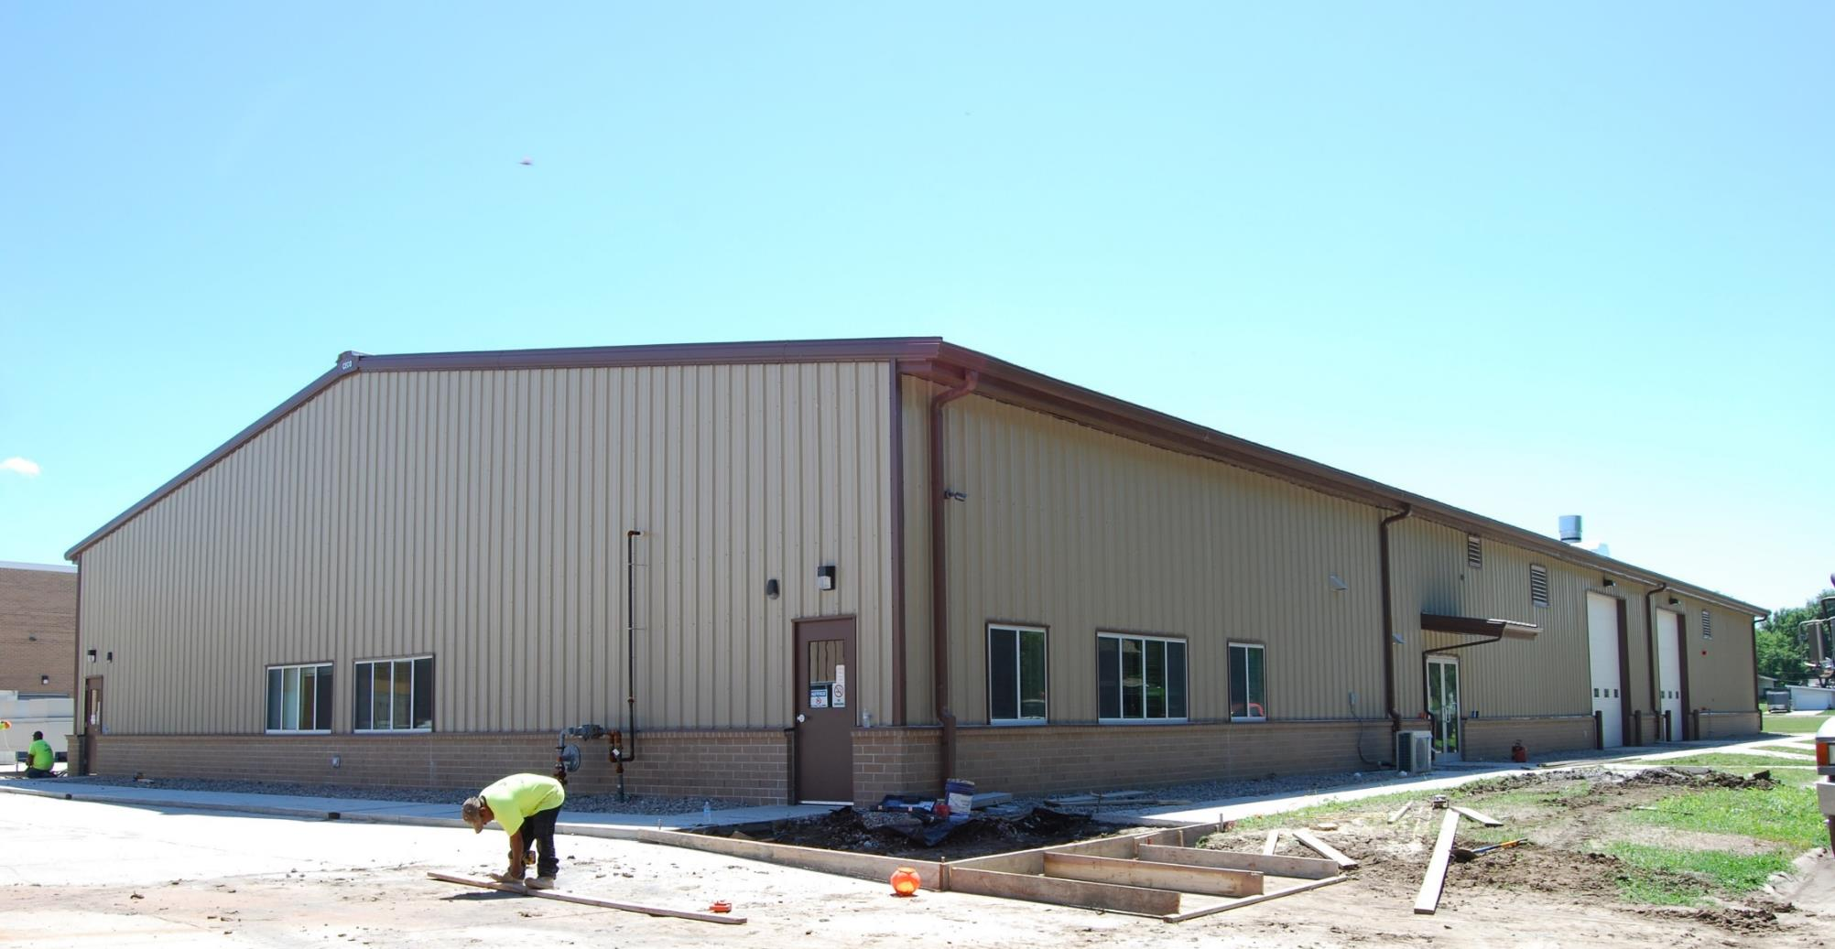
An example of a similar CTE Building
Notes:
Daryl: These are some examples of similar buildings.
This is what goes into a building like this (use talking points).

Slide 14
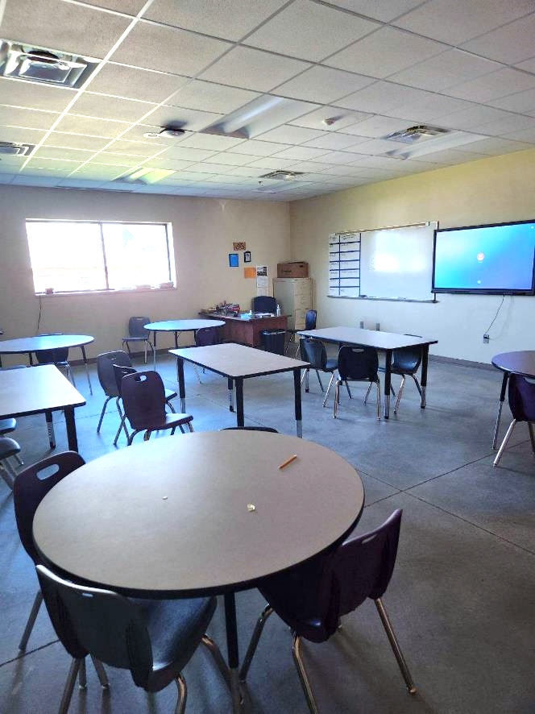
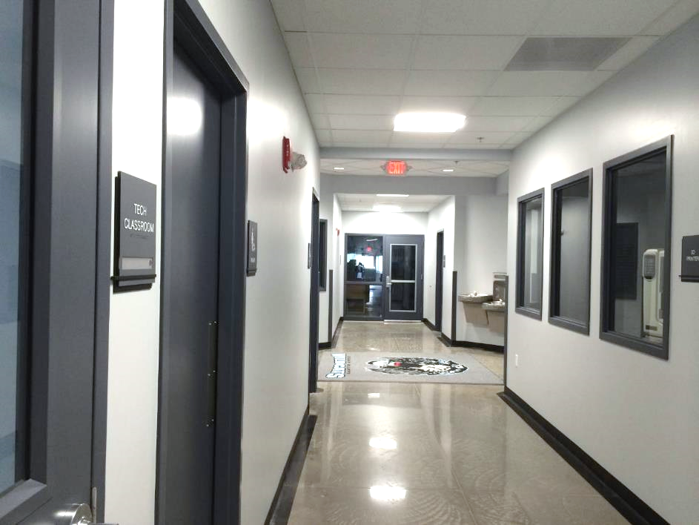
Examples of similar finished corridor and classroom
Notes:
Daryl

Slide 15
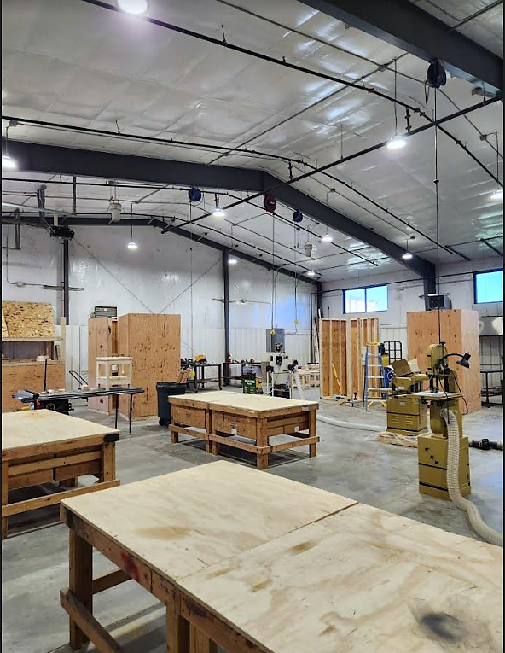
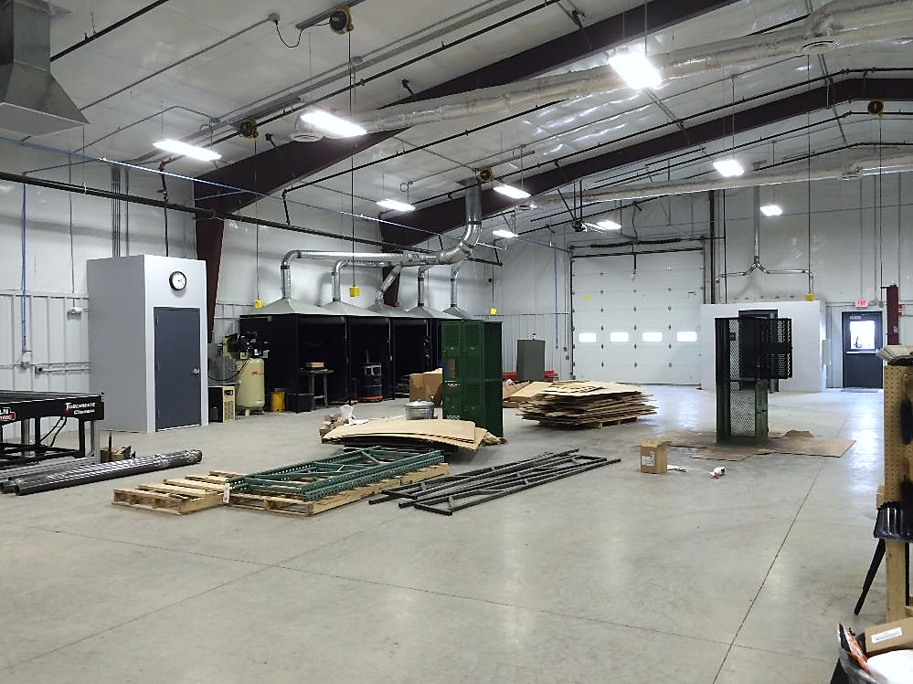
Examples of similar shop spaces
Notes:
Daryl

Slide 16
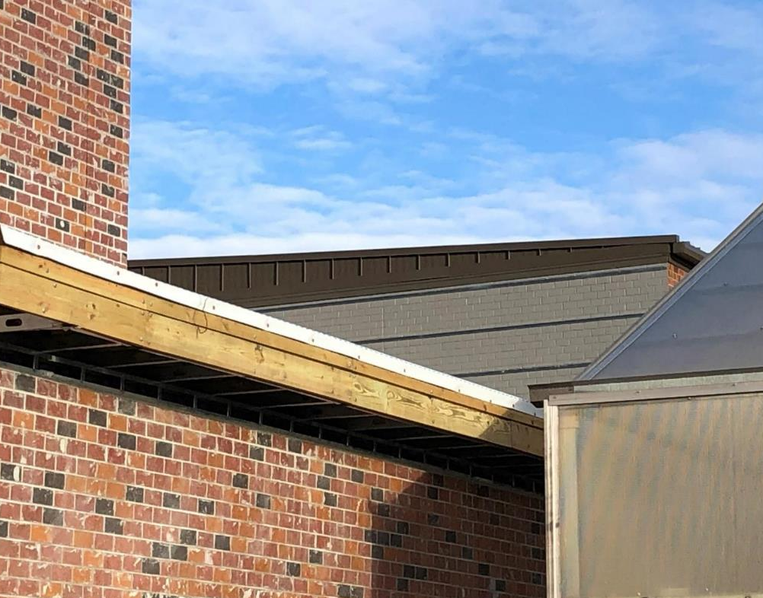
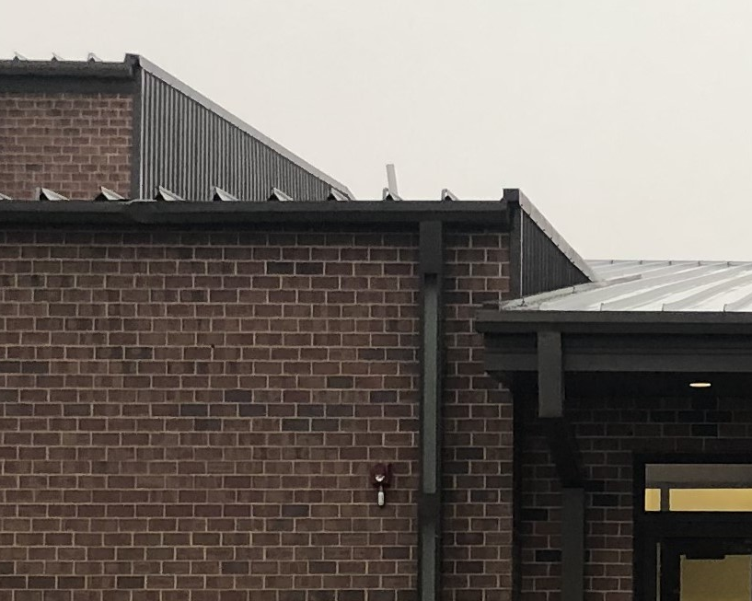
Randolph High School
Notes:
Daryl discuss improvements needed at this building. Structural damage around chimney
Leaking where the lower roof abuts the original gymnasium
Potential for mold/roof leak along west wall of north gymnasium

Slide 17
Structural Repairs and Roofing
Construction Solutions
Replace all damaged decking
Install new sloped insulation system and EPDM roofing
Apply weather barrier to existing gymnasium brick wall
Install rain screen with proper flashings

Slide 18
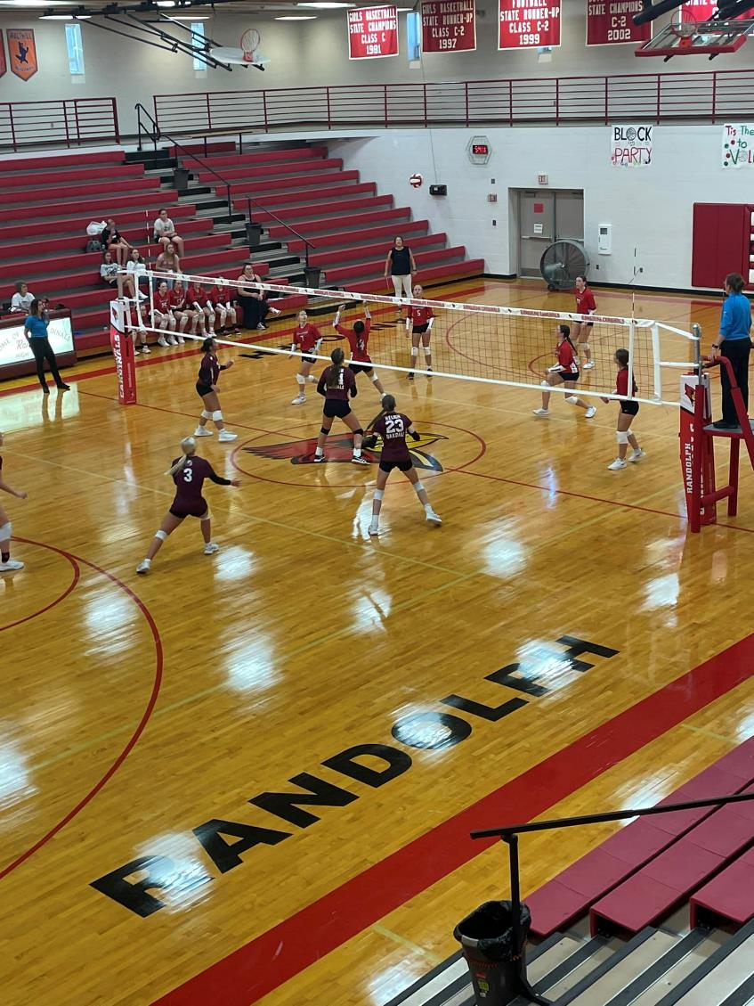
Air Conditioning
Construction Solutions
New air handling units, relief fans, damper actuators, CO2 sensors in main gym
Upgrade controls for maximum efficiency
Upgrade electrical
Reuse existing ductwork when possible
Notes:
Daryl: one of few schools that don’t have AC in gym. Kids in building throughout the summer for summer conditioning. Activities year-round (graduation, etc.). A lot of people have told us that it’s time that we do this.

Slide 19
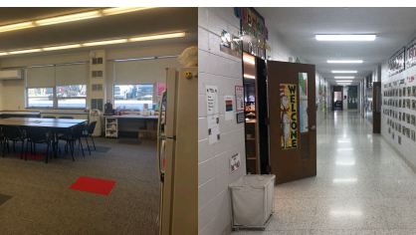
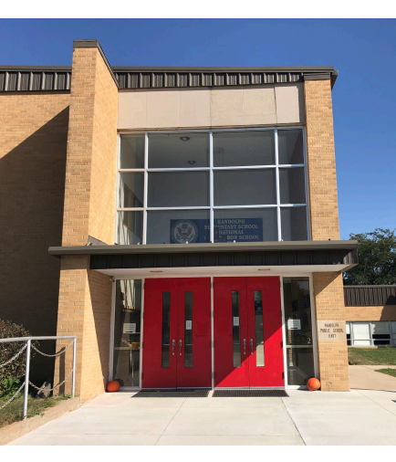
Elementary School
Florescent vs LED
Notes:
Denton discuss needed upgrades. Could have teacher/parent of students share some anecdotal information about some of the challenges. Focus on efficiency, learning environment and pain points that need to be addressed: rest room configuration and ADA accessibility; transporting for lunch, entry, heating and cooling, lighting, electrical.
Improve security at main entrance
Eliminate daily travel of elementary students to Jr/Sr High for lunch

Slide 20
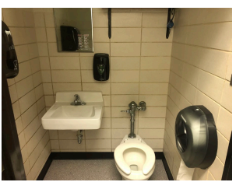
Elementary School
Notes:
Daryl/Denton discuss needed upgrades. Could have teacher/parent of students share some anecdotal information about some of the challenges. Focuse on efficiency, learning environment and pain points that need to be addressed: rest room configuration and ADA accessibility; transporting for lunch, entry, heating and cooling, lighting, electrical.

Slide 21
Elementary Upgrades
CONSTRUCTION SOLUTIONS
Provide a secure vestibule​
Update the electrical system​​
Install energy efficient windows
Replace original boiler with new HVAC
Install fire sprinklers & modern fire alarms
Create ADA accessible restrooms
Provide a Girls' restroom on the second floor
Add a Boys' restroom on the first floor
Reduce lost classroom time and busing by adding a serving kitchen​
Install energy efficient lighting
Replace ceilings

Slide 22
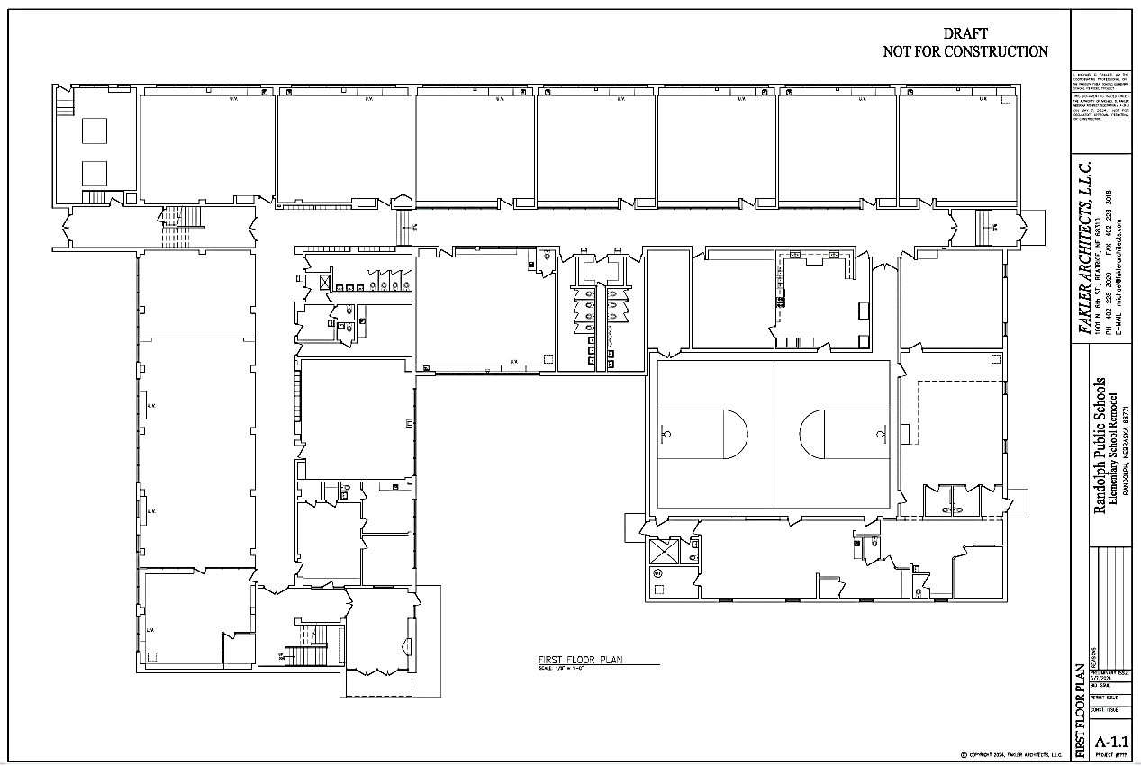
Notes:
Denton and Daryl: Restrooms and where serving kitchen will go

Slide 23
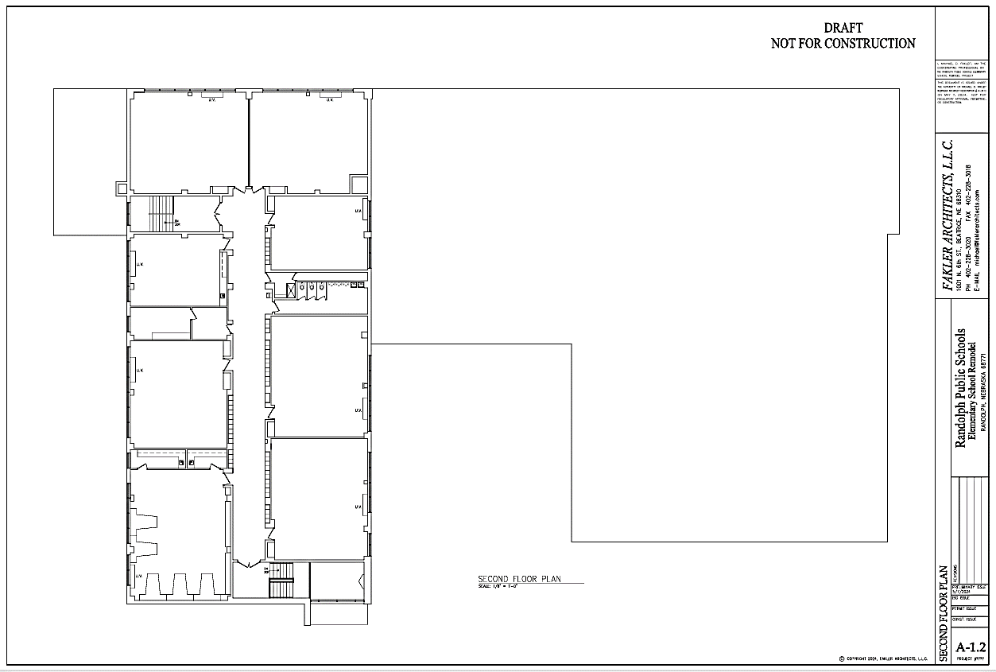

Slide 24
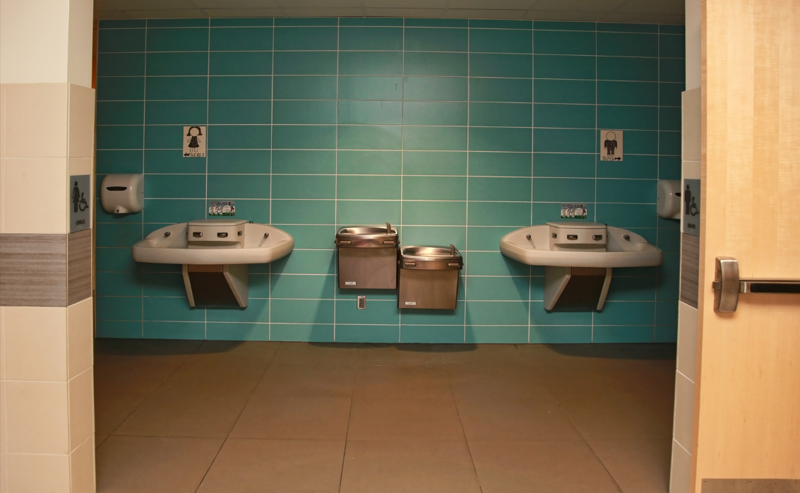
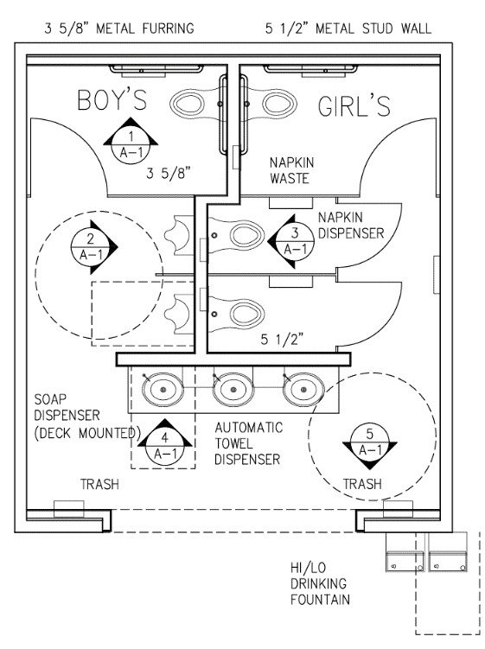
Bathrooms

Slide 25
Project Cost Estimates
Career & Technical Education Building: $4,209,945
Middle/High School: $646,000
Elementary: $4,894,055
Total Estimated* Cost: $9,750,000
*Following successful passage of bond, complete architectural plans will be designed and the project will be competitively bid.
Notes:
Daryl – quick review

Slide 26
Financial Information
District comparisons/tax impact

Slide 27
District Financial Information
2024-25 Valuation $901,613,911
Tax Revenue Per Cent $90,161
2024-25 Levy
General .374749
Building .005602
Bond .000000
Total .380351
Notes:
Tobin

Slide 28
District Financial Information
2024-25 Valuation $901,613,911
Property $234,861,956 (26%)
Ag Land $666,751,955 (74%)
LB 2 Valuation $697,884,147
Property $234,861,956 (34%)
Ag Land $463,022,191 (66%)
Tax Revenue Per Cent $90,161
Bond Levy Revenue per cent $69,788
LB2 reduces ag land to 50% of market value for purposes of bond issue
Notes:
Tobin

Slide 29
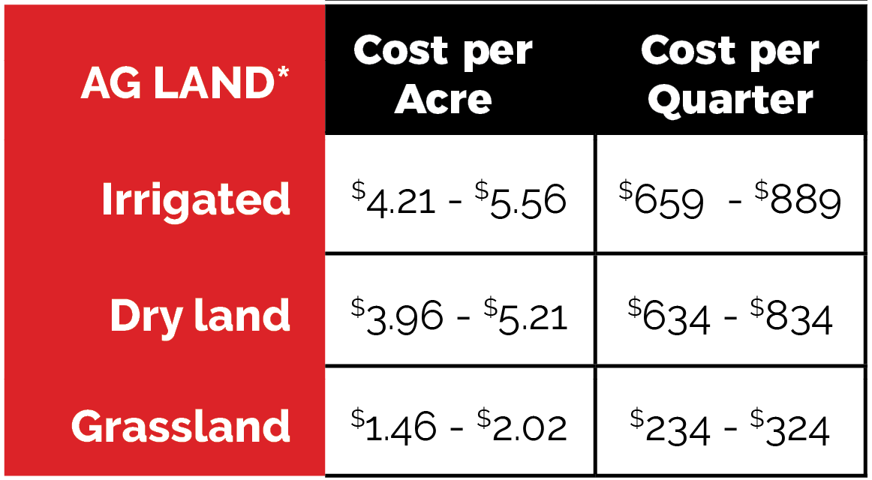
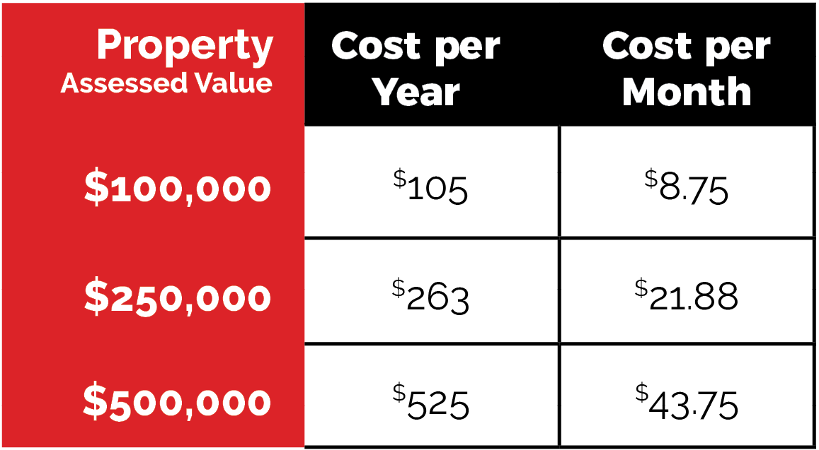
Bond Issue Impact
$9,750,000 Par Amount @ 20 years (around 4.30%)
Bond tax levy impact = 10.5 cents/ $100 of valuation
Notes:
Tobin Ag land using the range of average assessed value per acre within Cedar, Pierce, and Wayne counties per NE Dept of Revenue 2024 report

Slide 30
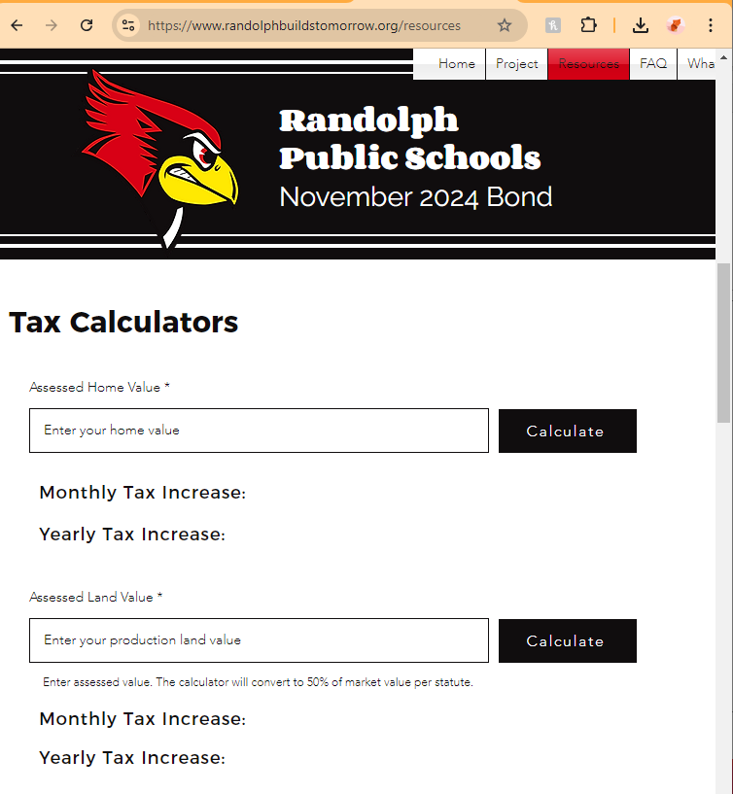
Tax Calculators
Under the Resources tab at
randolphbuildstomorrow.org
Notes:
Tobin Ag land using the range of average assessed value per acre within Cedar, Pierce, and Wayne counties per NE Dept of Revenue 2024 report

Slide 31
2023/24 Fiscal Year Area Levy Comparison
Wayne Community Schools 1.019535
Winside Public Schools 0.860691
Wausa Public Schools 0.850940
Pierce Public Schools 0.823448
LCC Public Schools 0.792679
Osmond Public Schools 0.733131
Allen Consolidated Schools 0.647255
Hartington Newcastle PS 0.495307
Randolph Public Schools 0.418675
Notes:
Lucas … based on last year’s information.

Slide 32
2023/24 Fiscal Year Area Valuation Comparison
Hartington Newcastle PS $1,268,850,009
Wayne Community Schools $1,184,196,049
LCC Public Schools $1,102,258,192
Pierce Public Schools $962,367,704
Randolph Public Schools $798,574,991
Winside Public Schools $525,770,779
Osmond Public Schools $452,176,084
Allen Consolidated Schools $405,754,096
Wausa Public Schools $405,057,688
Notes:
Lucas

Slide 33
2023/24 Fiscal Year Tax Request Comparison
Wayne Community Schools $11,791,452
LCC Public Schools $ 8,737,374
Pierce Public Schools $ 7,924,602
Hartington Newcastle PS $ 6,284,706
Winside Public Schools $ 4,526,671
Wausa Public Schools $ 3,446,802
Randolph Public Schools $3,343,434
Osmond Public Schools $ 3,315,040
Allen Consolidated Schools $ 2,626,263
Notes:
Lucas

Slide 34
2023/24 Fiscal Year Area Per Pupil Cost
Allen Consolidated Schools $30,394
LCC Public Schools $26,719
Osmond Public Schools $25,728
Wausa Public Schools $21,931
Winside Public Schools $21,900
Randolph Public Schools $21,661
Hartington Newcastle PS $20,936
Pierce Public Schools $15,526
Wayne Community Schools $14,005
*State Average $16,213
Notes:
Lucas

Slide 35
2023/24 Fiscal Year Tax Request Per Pupil*
LCC Public Schools $21,053
Osmond Public Schools $19,500
Winside Public Schools $18,557
Allen Consolidated Schools $18,494
Wausa Public Schools $15,957
Hartington Newcastle PS $15,712
Randolph Public Schools with bond $15,631
Randolph Public Schools $12,859
Wayne Community Schools $11,827
Pierce Public Schools $11,485
Notes:
Lucas

Slide 36
Important Questions

Slide 37
How can we be sure this can be built for the amount budgeted?
The board engaged an architect and construction manager at the beginning of the project to ensure they are working as a team on design concepts and budgeting. This model provides as much confidence as possible without full spec documents and actual bids. The project will be competitively bid following final construction drawings.
Notes:
Scott & Mike introduce CM role and then talk about this process to arrive at the estimate
Then if this passes, the role in overseeing bidding, local subcontractors

Slide 38
How will construction impact student learning?
Most intrusive construction scheduled when school not in session
Organized and phased approach to reduce interruption
Focus on safety and communication
Experience in occupied school construction
Notes:
Scott and Mike. This is who we are and what we do.

Slide 39
How will the district address other needs not included in the bond issue?
The district will continue to address other facility needs through the Depreciation Fund and Special Building Fund through a short- and long-term facility maintenance plan.
Notes:
Daryl

Slide 40
What if the bond fails?
Our needs do not go away
Listen to community feedback
Costs will most likely increase
Must wait at least 6 months
Notes:
Cody/Daryl (Tobin if needed to talk about legal): Went through a thorough process—a lot of work has gone into this solution. This is a good solution most economical with significant impact. This is the project we believe in. If it doesn’t pass, more than likely we will get less bang for our buck.

Slide 41
Public Q&A
Notes:
Daryl: We want to respect your time but allow time for folks to ask questions that haven’t been answered and share your comments. In the interest of time, we’ll allow about 15 to 20 minutes so people can get home, but if your question isn’t answered, we’ll stick around and you can visit with us. We will pass around a microphone, so raise your hand if you have a question and we’ll come to you. Afterward, we will offer tours for anyone who is interested. You can walk around or we can take you on a tour and ask questions on the tours.

Slide 42
Supplemental Slides

Slide 43
Tax Implications: One Example
Home/Buildings/Personal Property
$750,000 Pre LB2 X .00081 (8.1 cents) = $608
$750,000 Post LB2 X .00105 (10.5 cents) = $788
Ag Land
$5,000,000 market (appraised) value owned
$3,600,000 (72%) Pre LB2 X .00810 (8.1 cents) = $2,916
$2,500,000 (50%) Post LB2 X .00105 (10.5 cents) = $2,625
Annual tax increase Pre LB2 = $3,524
Annual tax increase Post LB2 = $3,413
(-$111 per year)

Slide 44
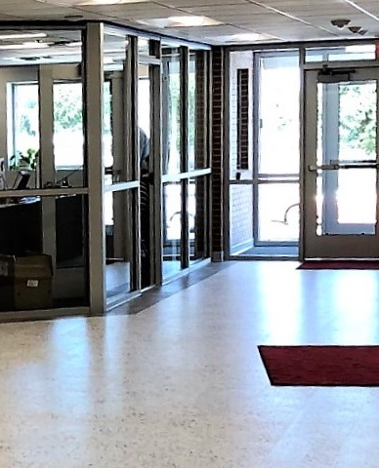
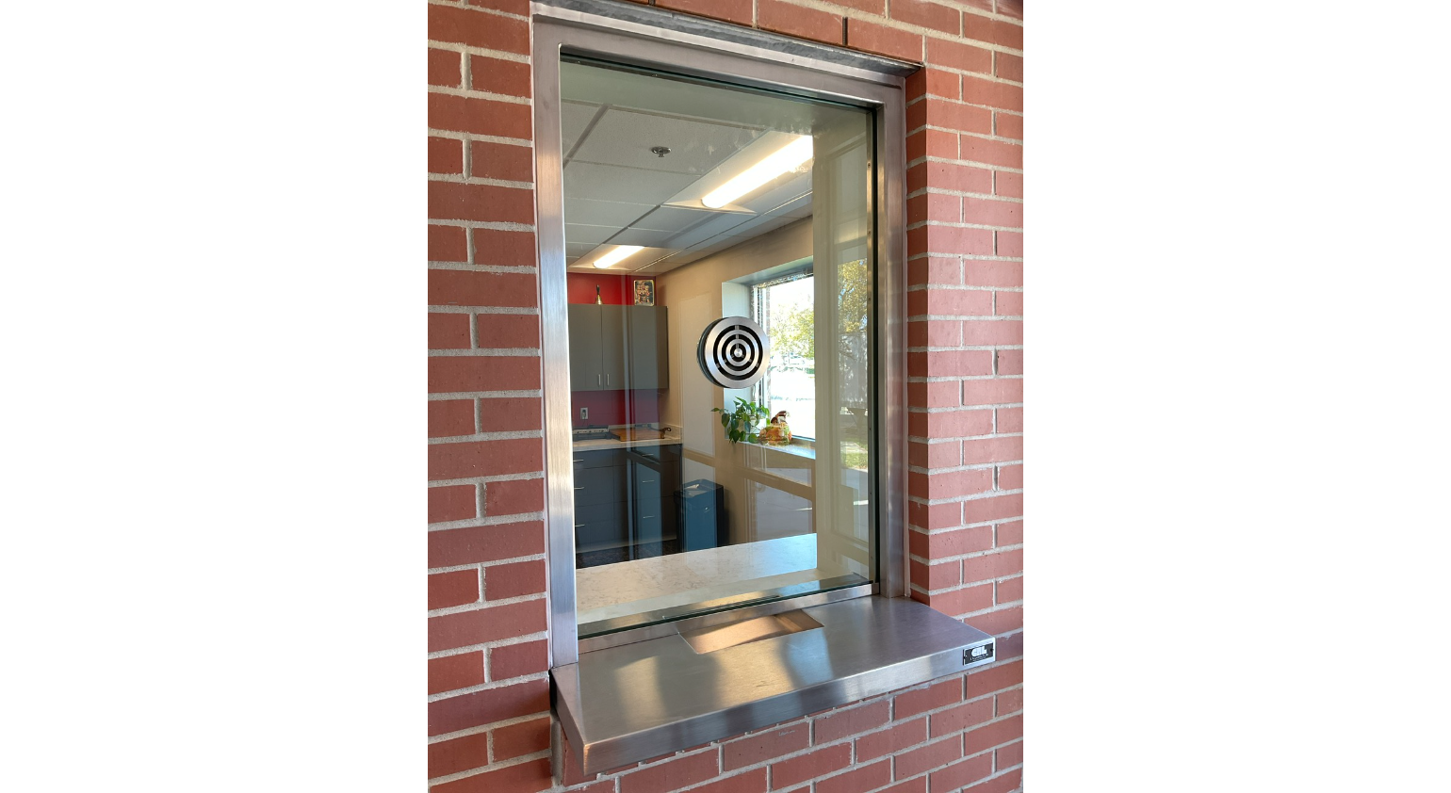
Secure Main Entrance
Construction solutions
Replace borrowed-light window at principal’s and secretary’s office
Provide security pass-through at secretary’s window
Provide new security door to corridor
Provide steel bollards

Slide 45
Serving Kitchen Addition
Construction solutions
Add slab-on-grade addition, approximately 900 sq. ft.
Utilize ICF structure with light-gage metal roof trusses
Addition will contain a kitchen with serving area that can double as table storage

Slide 46
HVAC System Replacement
concerns
Construction Solutions
Existing HVAC systems inefficient and inadequate
Remove all existing equipment and materials
Install new ducted water-sourced heat pump units
New boiler and chiller system
Electrical service will be upgraded

Slide 47
Electrical Upgrades
concerns
Construction solutions
Electrical service inadequate and unsafe
Provide eight surface-mounted receptacles and two new 20-amp circuits per classroom
In the library, provide 10 surface-mounted receptacles and two 20-amp circuits

Slide 48
Lighting Upgrades
Concerns
Construction solutions
Existing fluorescent lighting inefficient and outdated
Install new 2x2 recessed LED troffers
Provide classrooms and library with dimmer switches
Provide emergency battery back-up
Provide occupancy sensors

Slide 49
Fire Sprinklers
concerns
Construction solutions
No fire sprinklers
Provide new 4-inch fire sprinkler service
Include backflow preventer and required accessories
Provide connection to fire alarm system as required

Slide 50
Corridor Ceilings
concerns
Construction solutions
Replace corridor ceilings
Remove existing corridor ceilings
Install new 2’x2’ mineral fiber suspended ceiling tiles

Slide 51
Windows
concerns
Construction Solutions
Replace exterior windows
Replace all window with OPTIQ AA5450 series windows by Kawneer with 1 ½” triple glazed tempered glass

Slide 52
Restroom Renovations
concerns
Construction solutions
Add boys’ restroom on 1st floor
Demo existing girls’ north restroom and adjacent office uni-sex restrooms and janitor’s closet
Lay out new boys’ and girls’ restrooms
Provide all new fixtures and finishes
Create new janitor’s closet

Slide 53
Restroom Renovations, cont.
objectives
Construction solutions
Add girls’ restroom on 2nd floor
Utilize existing storage room east of existing boys’ restroom
Lay out new boys’ and girls’ restrooms
Provide all new fixtures and finishes
Create new janitor’s closet

Slide 54
Restroom Renovations, cont.
objectives
Construction solutions
Update existing restrooms and possibly move sinks to hallway
Gut and reconfigure south restrooms on first floor to match new north restrooms

