Slide 1
Facility Project
Public Information Meeting
August 1, 2024

Slide 2
Meeting Objectives
Welcome/Introductions
Facility Needs
Project Solution
Financial Impact
Important Questions

Slide 3
Facility Needs
Process/timeline

Slide 4
Facility Needs Process and Timeline
Oct 9, 2020
RPS requests proposals for Vocational Ag building design
Mar 3, 2021
RPS signs contract with Fakler Architects for Vo Ag design
Apr 16, 2021 Vocational Ag building design begins
February 4, 2022
Vocational Ag building design completed
Mar 17, 2022 Vocational Ag Building bids due. Lone bid received: $3,952,100
Nov 2, 2023 Architect and Construction Manager tour RPS
Jan 3, 2024
Audit of facility gets underway, including structural review and needs assessment discussions with staff & maintenance
January 30, 2024 Abatement company site visit
February 26, 2024 Steering Committee Kickoff. Members review final Facility Audit; tour areas under consideration for bond; review needs list to date.
April 4, 2024
Small groups brainstorm facility needs; compile into overall needs list. Discuss process, Facility Audit Summary, Priority Activity & Survey
April 18, 2024
Steering committee performs final needs ranking; reviews financial impact & VoAg bldg cost estimates; tours HS hall by PA gym & Elementary
Early June 2024: Fakler Architects sends conceptual drawings and narrative to BD Construction for cost estimating
Mid-June 2024
BD Construction estimates costs and performs construction review
June 25, 2024 Steering committee discusses, estimated costs and preliminary tax impact.
August 1, 2024 Public Information Meeting and
School Tours
August 12, 2024
BOE Agenda to include: Steering Committee recommendation to approve project and budget. Bond election resolution.
Sept / Oct 2024 Bond information process including community presentations, tours, mailers, website, social media, community events, etc.
November 5, 2024 Election Day

Slide 5

Need/Objective
The Facility Audit and MEP Facility Audit are available on www.randolphpublic.org, along with the master list of needs and other facility project information.
As our architect, Michael Fakler, reviews Project Options, he will explain the Need/Objective for each solution.

Slide 6
Project Options
Conceptual ideas +
Preliminary cost estimates

Slide 7
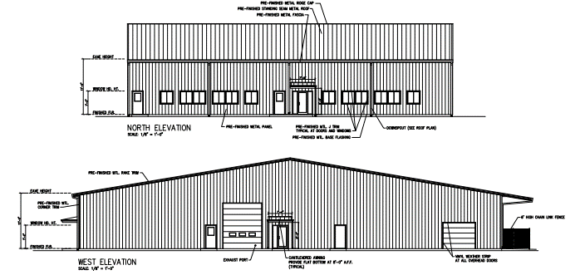
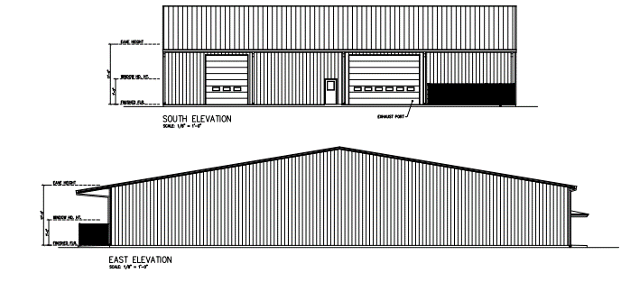
Vocational Building

Slide 8
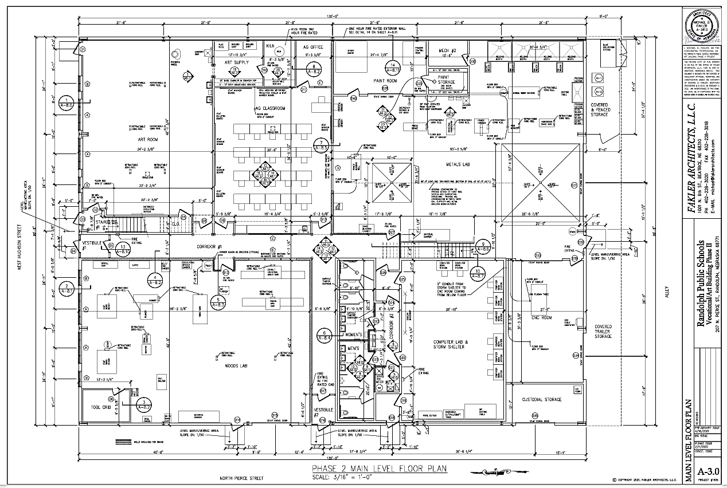

Slide 9
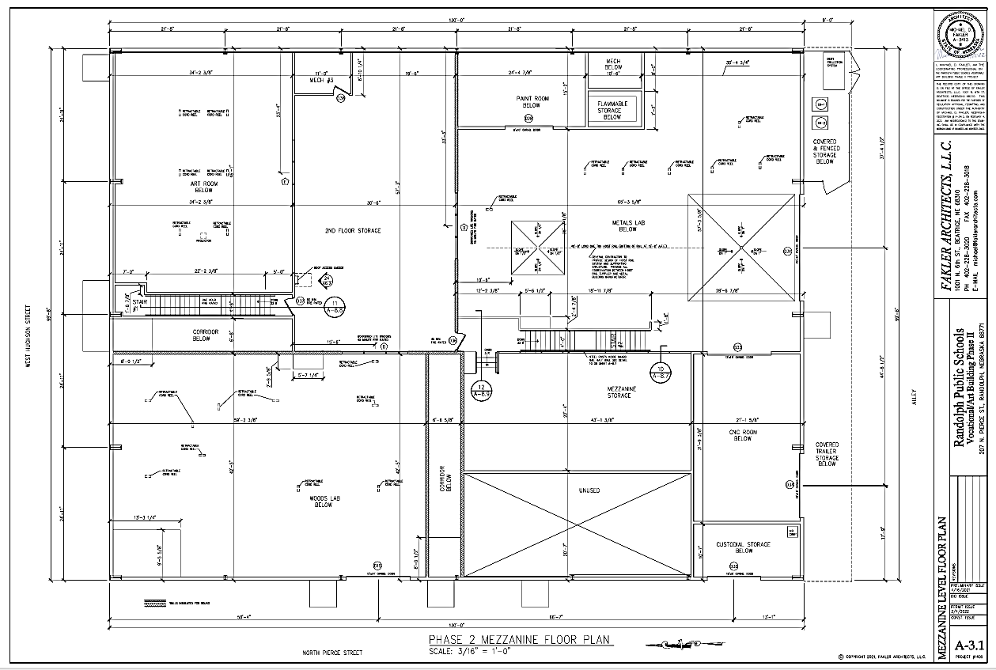

Slide 10
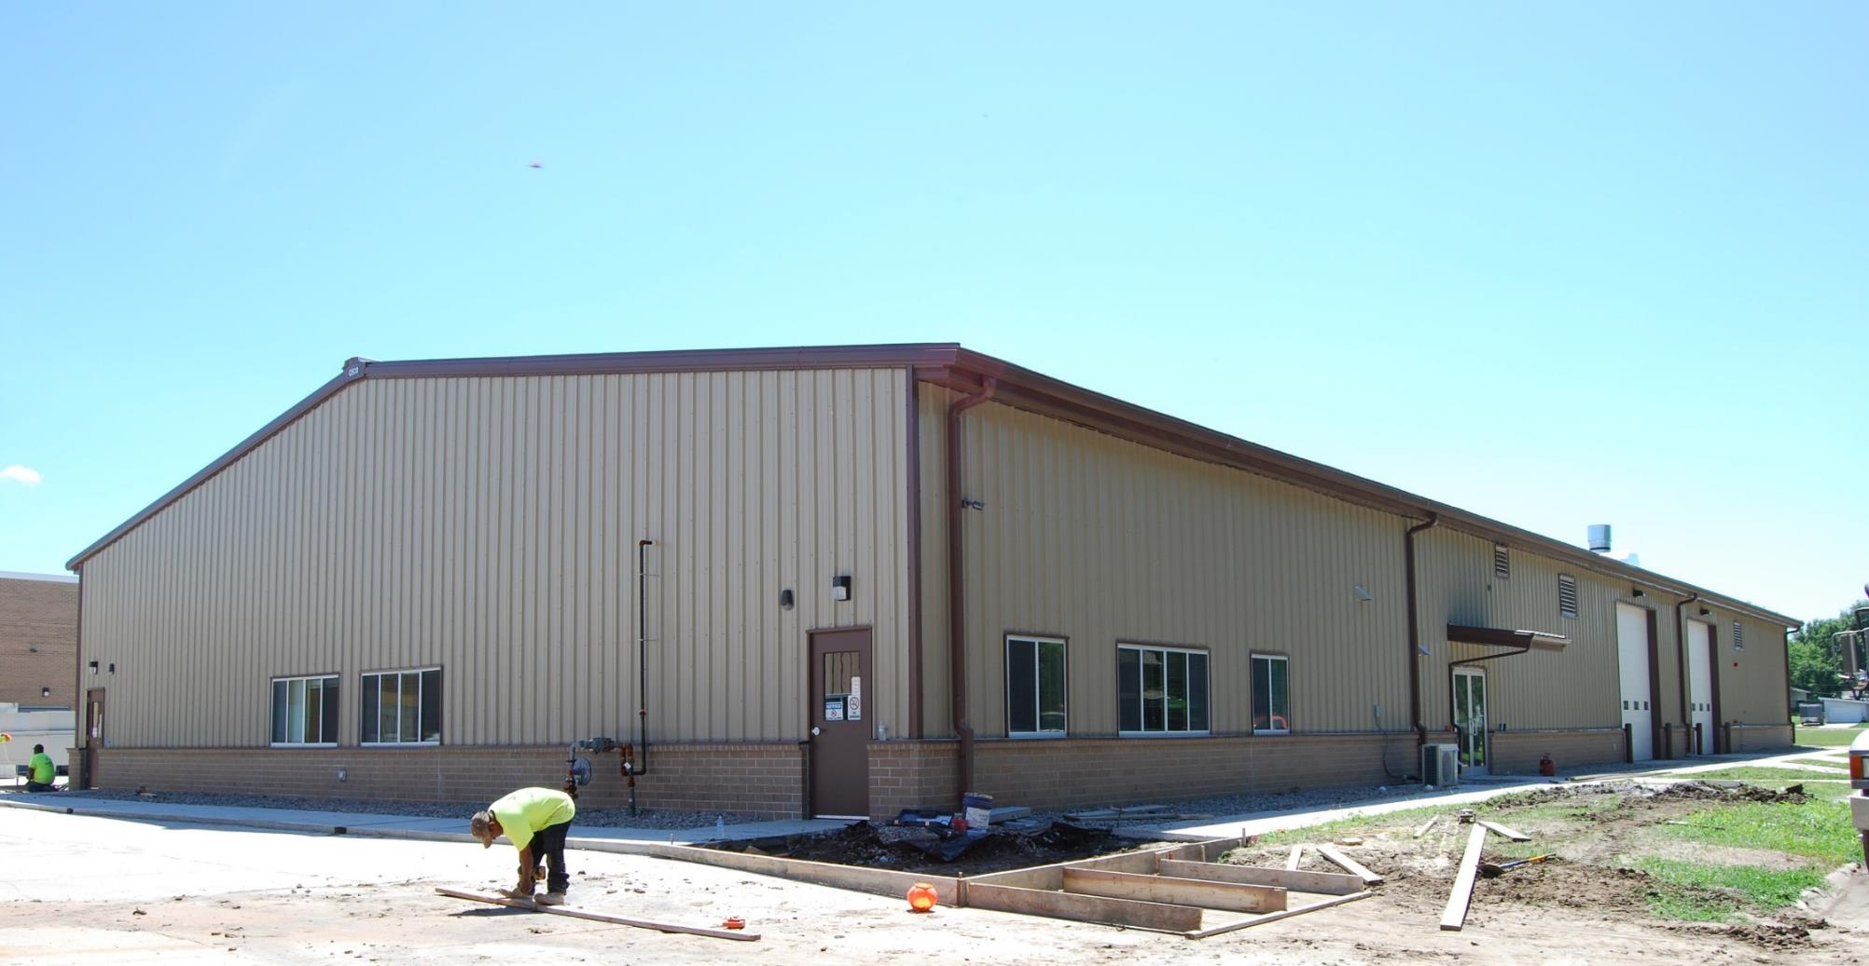

Slide 11
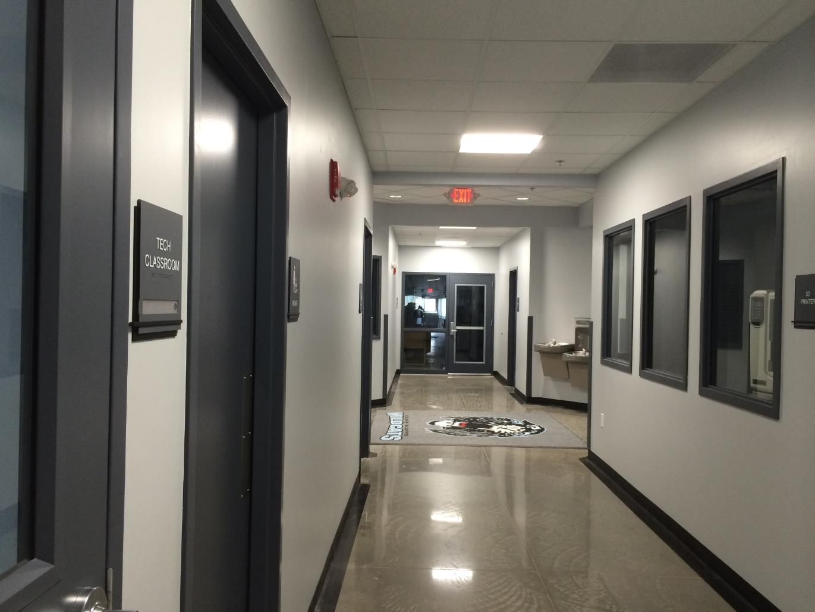

Slide 12
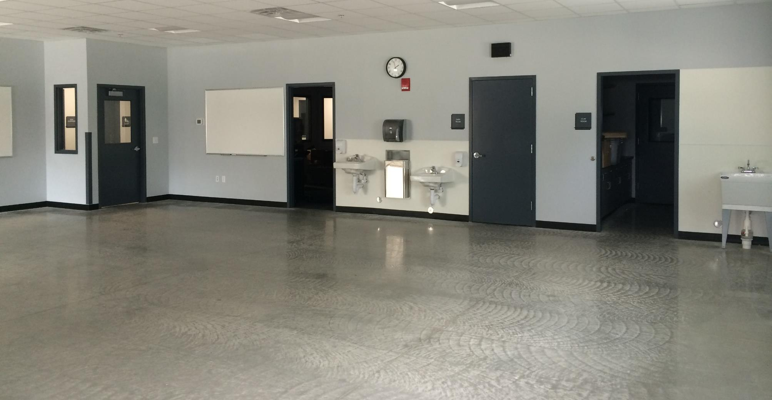

Slide 13
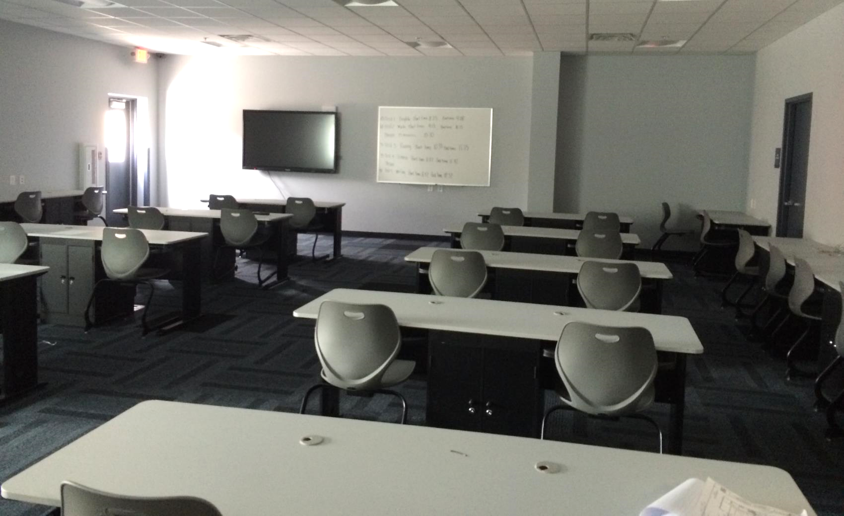

Slide 14
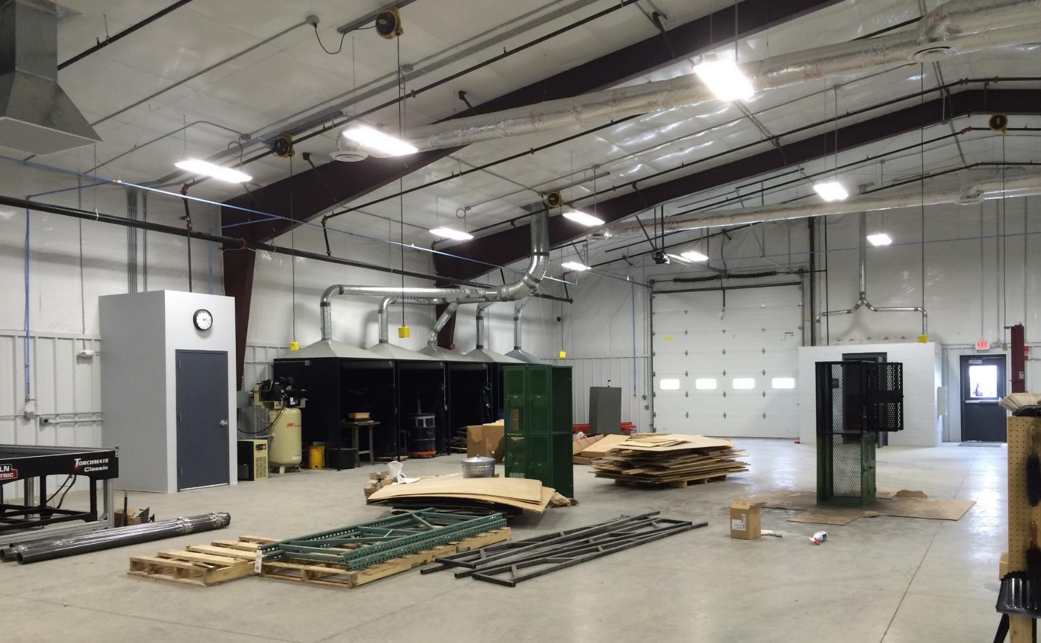

Slide 15
Middle/High School

Slide 16
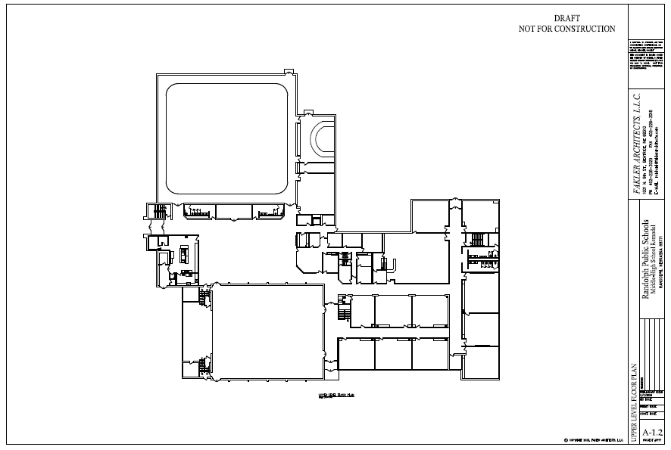

Slide 17
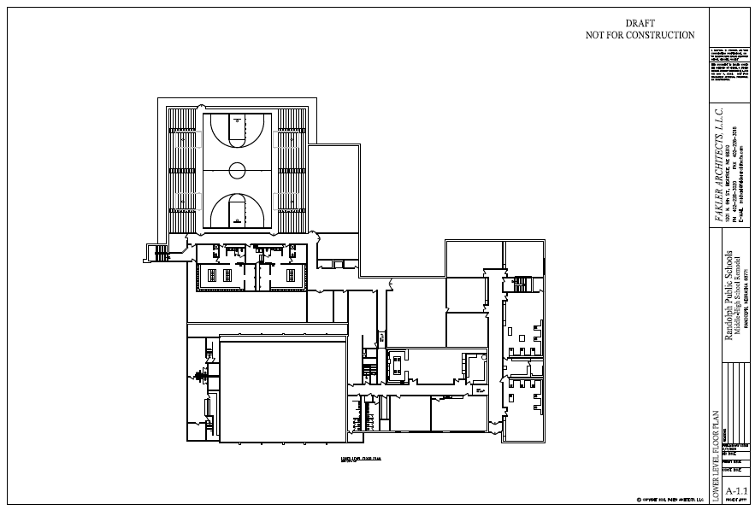

Slide 18
Structural Repairs and Roofing
Objectives
Construction Solutions
Evaluation of structural damage around the chimney
Repair and replacement of decking, insulation, and roofing
Current leak where the lower roof abuts the original gymnasium
Investigation of potential mold/roof leak along west wall of north gymnasium
Replace all damaged decking
Install new sloped insulation system and EPDM roofing
Apply weather barrier to existing gymnasium brick wall
Install rain screen with proper flashings
TBD

Slide 19
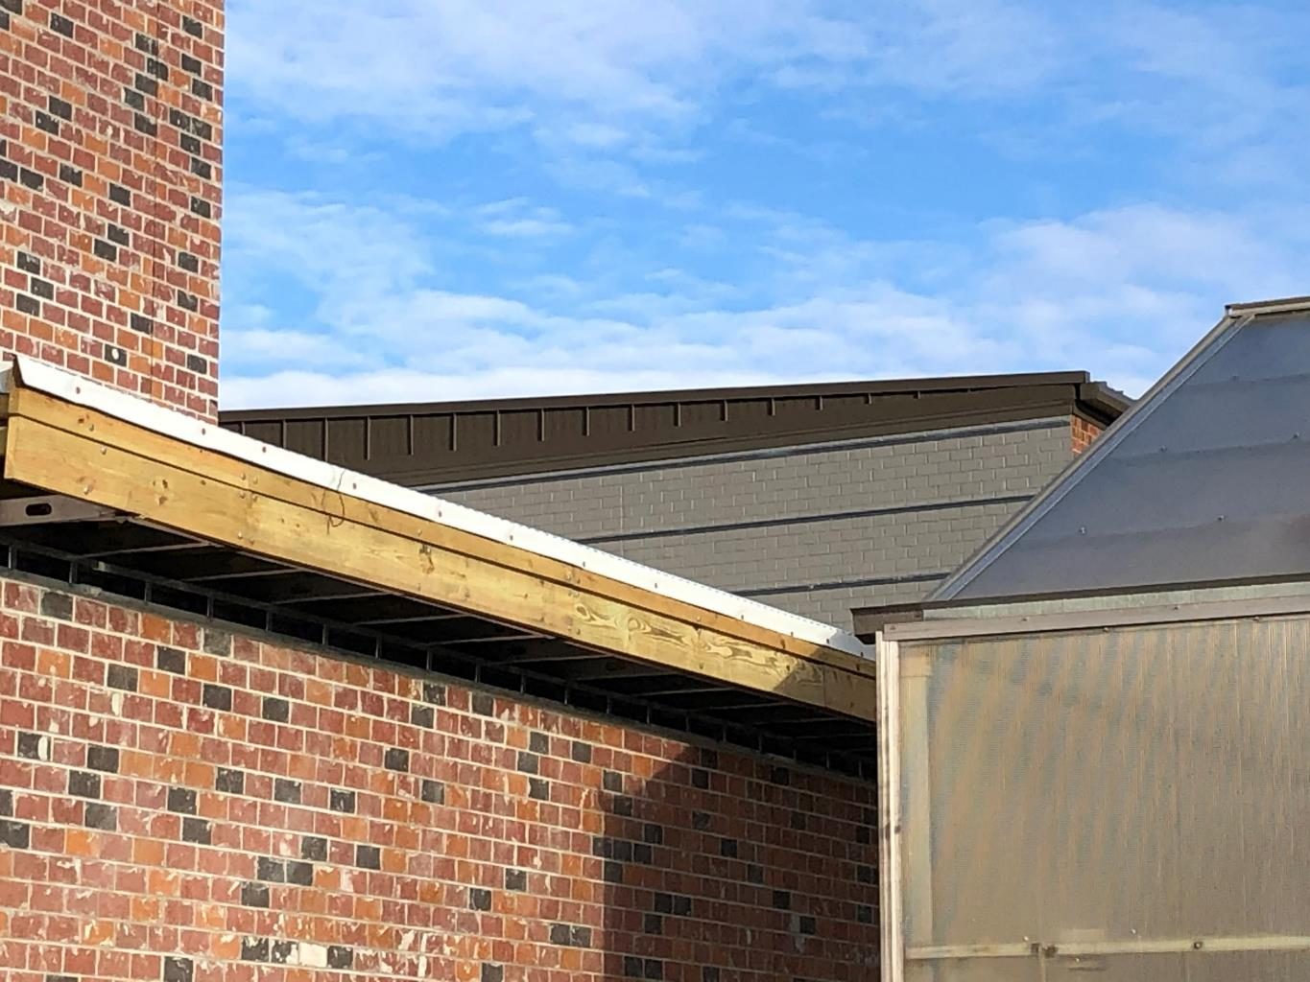

Slide 20
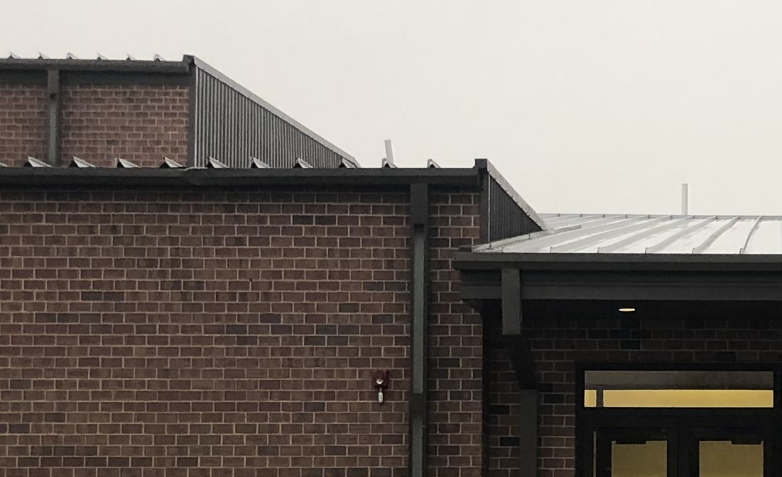

Slide 21
HVAC and Air Conditioning
Objectives
Construction Solutions
Replace existing air handler units in mechanical room 208
Provide two new air handling units
  Reuse existing ductwork when possible
  New condensing units
Replace existing relief air fans
Replace damper actuators
Provide CO2 sensers
Upgrade controls
Provide electrical powers required
A/C and fans to be added to the new gym

Slide 22
Elementary School

Slide 23
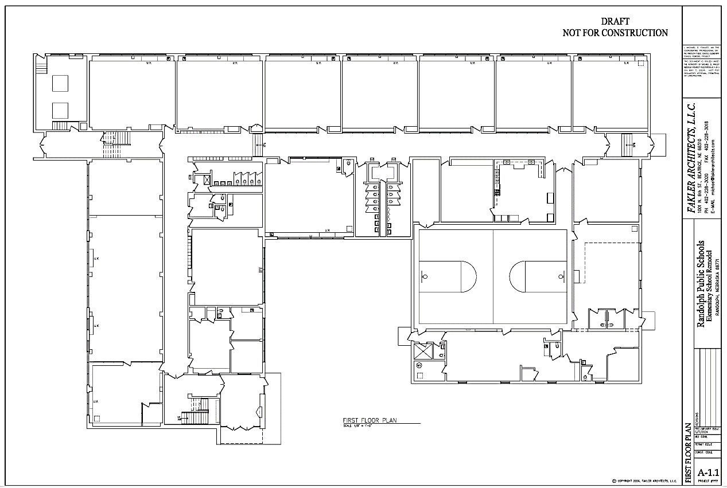

Slide 24
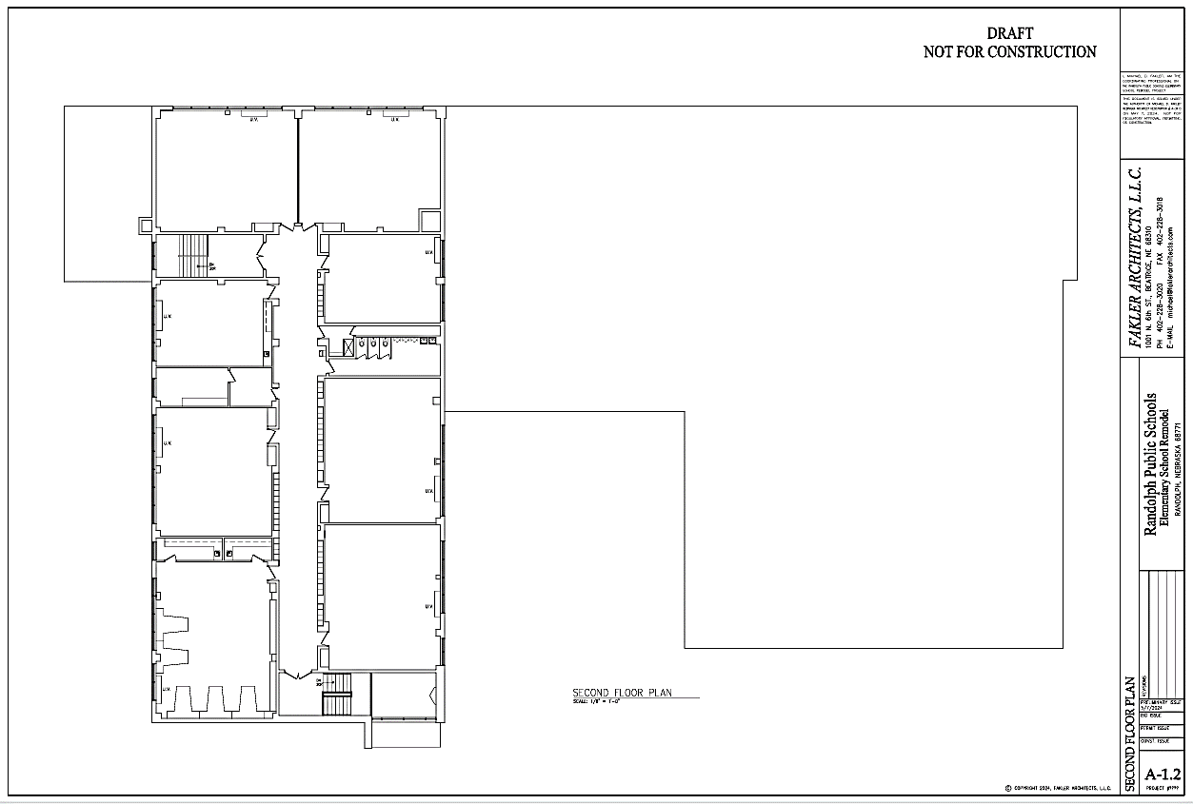

Slide 25
HVAC System Replacement
Objectives
Construction Solutions
Replace HVAC systems
Remove all existing equipment and materials
Install new ducted water-sourced heat pump units
  Option 1 – new boiler and chiller system
  Option 2 – geothermal well-field system
  Electrical service will be upgraded

Slide 26
Electrical Upgrades
objectives
Construction solutions
Add electrical outlets in classrooms
Provide eight surface-mounted receptacles and two new 20-amp circuits per classroom
In the library, provide 10 surface-mounted receptacles and two 20-amp circuits

Slide 27
Lighting Upgrades
objectives
Construction solutions
Replace existing fluorescent lighting with LED
Install new 2x2 recessed LED troffers
Provide classrooms and library with dimmer switches
Provide emergency battery back-up
Provide occupancy sensors

Slide 28
Fire Sprinklers
Objectives
Construction solutions
Add fire sprinklers to the building
Provide new 4-inch fire sprinkler service
  Include backflow preventer and required accessories
  Provide connection to fire alarm system as required

Slide 29
Corridor Ceilings
objectives
Construction solutions
Replace corridor ceilings
Remove existing corridor ceilings
Install new 2’x2’ mineral fiber suspended ceiling tiles

Slide 30
Windows
objectives
Construction Solutions
Replace exterior windows
Replace all window with OPTIQ AA5450 series windows by Kawneer with 1 ½” triple glazed tempered glass

Slide 31
Restroom Renovations
objectives
Construction solutions
Add boys’ restroom on 1st floor
Demo existing girls’ north restroom and adjacent office uni-sex restrooms and janitor’s closet
Lay out new boys’ and girls’ restrooms
Provide all new fixtures and finishes
Create new janitor’s closet

Slide 32
Restroom Renovations, cont.
objectives
Construction solutions
Add girls’ restroom on 2nd floor
Utilize existing storage room east of existing boys’ restroom
Lay out new boys’ and girls’ restrooms
Provide all new fixtures and finishes
Create new janitor’s closet

Slide 33
Restroom Renovations, cont.
objectives
Construction solutions
Update existing restrooms and possibly move sinks to hallway
Gut and reconfigure south restrooms on first floor to match new north restrooms

Slide 34
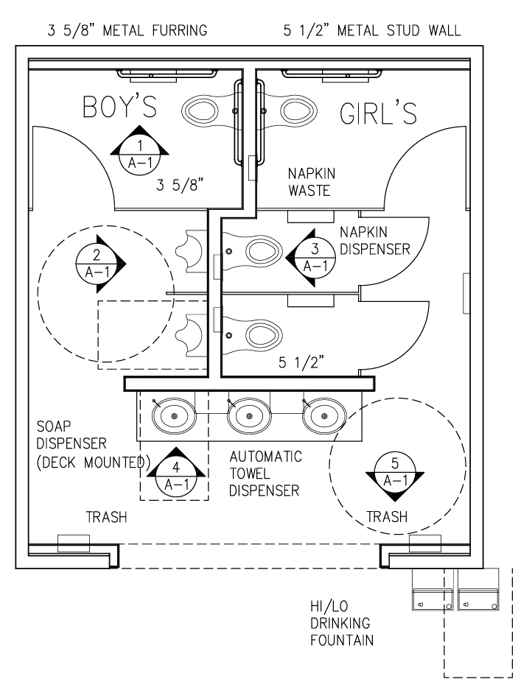

Slide 35
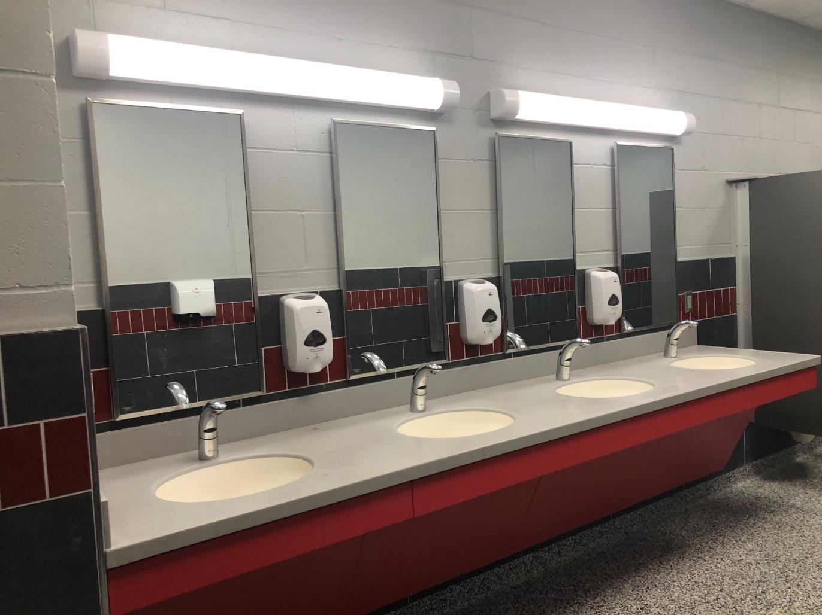

Slide 36
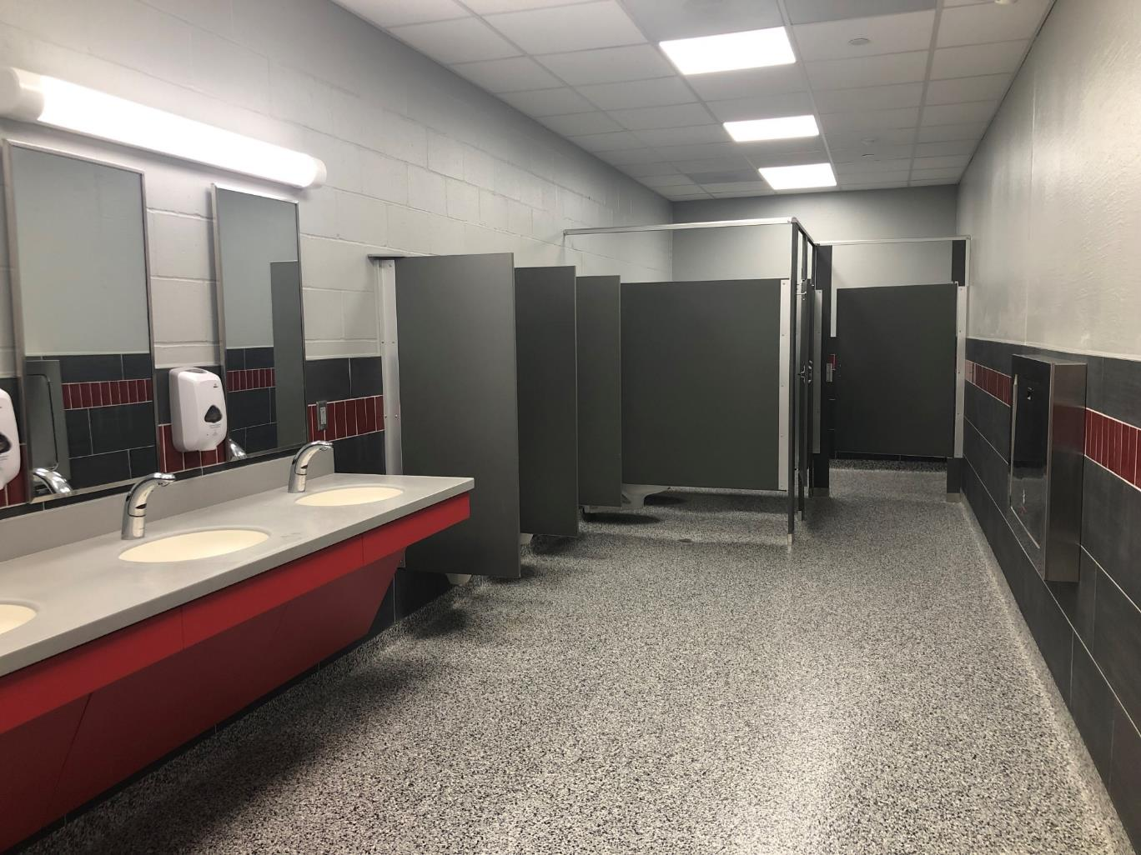

Slide 37
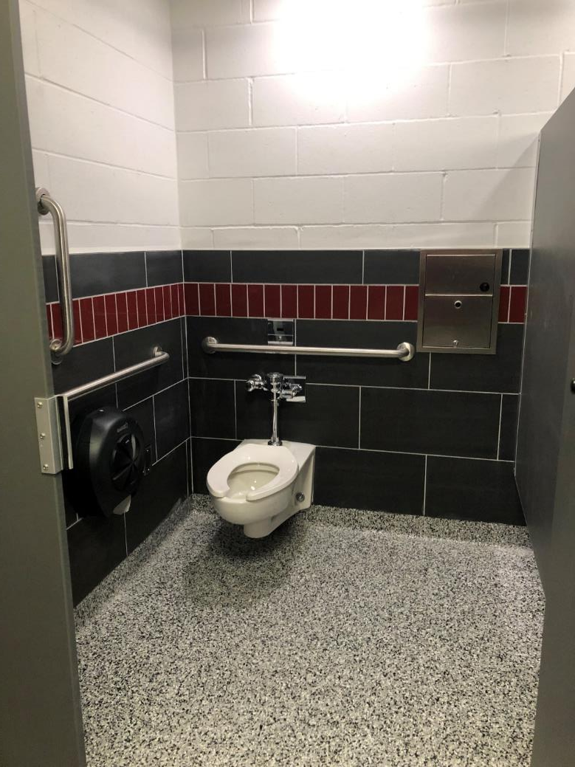

Slide 38
Main Entrance Security
Objectives
Construction solutions
Improve security at main entrance
Replace borrowed-light window at principal’s and secretary’s office
Provide security pass-through at secretary’s window
Provide new security door to corridor
Provide steel bollards

Slide 39
Kitchen Addition
objectives
Construction solutions
Add kitchen in courtyard area north of gymnasium
Add slab-on-grade addition, approximately 900 sq. ft.
Utilize ICF structure with light-gage metal roof trusses
Addition will contain a kitchen with serving area that can double as table storage

Slide 40
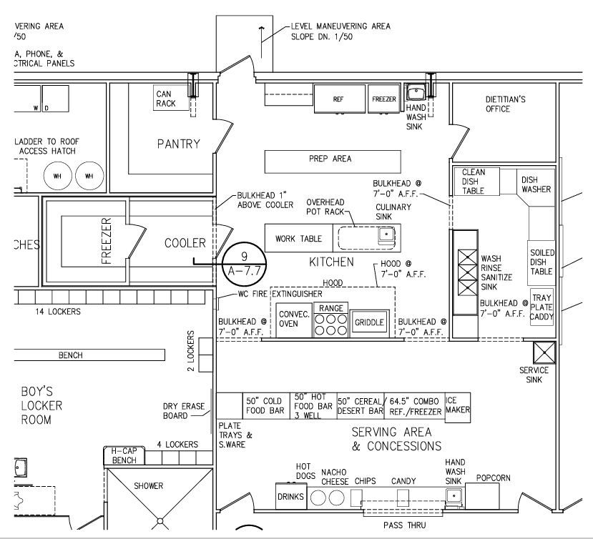

Slide 41
Project Cost Estimates
Vocational Ag Building: $4,209,945
Middle/High School: $646,000
Elementary: $4,894,055
Total Estimated Cost*: $9,750,000
*Following successful passage of bond, complete architectural plans
will be designed and the project will be competitively bid.

Slide 42
Tax Impact
Conceptual ideas +
Preliminary cost estimates

Slide 43
District Financial Information
2023-4 Valuation $798,574,991
Tax Revenue Per Cent $79,857
2023-24 Levy
General .406026
Building .012649
Bond .000000
Total .418675

Slide 44
District Financial Information
2023-4 Valuation $798,574,991
Tax Revenue Per Cent $79,857
2023-24 Levy
LB 2 Valuation $626,826,490
Bond Levy Revenue per cent $62,682
LB2 reduces ag land to 50% of market value for purposes of bond issue.

Slide 45
2023/24 Fiscal Year
Area Levy Comparison
Wayne Community Schools 1.019535
Winside Public Schools 0.860691
Wausa Public Schools 0.850940
Pierce Public Schools 0.823448
LCC Public Schools 0.792679
Osmond Public Schools 0.733131
Allen Consolidated Schools 0.647255
Hartington Newcastle PS 0.495307
Randolph Public Schools 0.418675

Slide 46
2023/24 Fiscal Year
Tax Request Comparison
Wayne Community Schools $11,791,452
LCC Public Schools $8,737,374
Pierce Public Schools $ 7,924,602
Hartington Newcastle PS $ 6,284,706
Winside Public Schools $ 4,526,671
Wausa Public Schools $ 3,446,802
Randolph Public Schools $ 3,343,434
Osmond Public Schools $ 3,315,040
Allen Consolidated Schools $ 2,626,263

Slide 47
2023/24 Fiscal Year
Area Per Pupil Cost
Allen Consolidated Schools $30,394
LCC Public Schools $26,719
Osmond Public Schools $25,728
Wausa Public Schools $21,931
Winside Public Schools $21,900
Randolph Public Schools $21,661
Hartington Newcastle PS $20,936
Pierce Public Schools $15,526
Wayne Community Schools $14,005
*State Average $16,213

Slide 48
2023/24 Fiscal Year
Tax Request Per Pupil*
LCC Public Schools $21,053
Osmond Public Schools $19,500
Winside Public Schools $18,557
Allen Consolidated Schools $18,494
Wausa Public Schools $15,957
Hartington Newcastle PS $15,712
Randolph Public Schools $12,859
Wayne Community Schools $11,827
Pierce Public Schools $11,485
*Total tax request divided by enrollment

Slide 49
Bond Issue Impact (Preliminary)
$9,750,000 Par Amount @ 20 years (around 4.40%)
Bond tax levy impact = 11.5 cents/ $100 of valuation
$100,000 of property = $115 increase per year
Avg. Irrigated Acre = $4.80 increase per year
Avg. Irrigated Quarter = $768 increase per year

Slide 50
Important
Questions

Slide 51
When is the board considering running the bond issue?
The board is considering placing the issue on General Election to be held November 5th.

Slide 52
How will the district address other needs not included in the bond issue?
The district will continue to address other facility needs through the Depreciation Fund and Special Building Fund through a short- and long-term facility maintenance plan.

Slide 53
How will the public be informed about the bond issue?
A group made up of board members, administrators, and community members will work with our design/construction/finance team to inform the public, including:
Informational website
Social media posts
Informational flyers
Informational mailing
Small community group meetings
Town hall information meetings
Informational newspaper stories

