Slide 1
Bond Information Meeting
February 26 7pm Jr/Sr High school

Slide 2
Tonight’s Agenda
Welcome and Introductions
Prior Bond
Community Feedback/Board Work
What’s Different This Time?
Financial Impact Update
Next Steps

Slide 3
Prior Bond
timeline

Slide 4
Prior Bond Information
$9,750,000
10. 5 cent levy impact
Ag Building, HS improvements, Elementary Renovations
Voted on November 2024 General Election
Short by 8 votes (476 For/484 Against)

Slide 5
Community Feedback/Board Work

Slide 6
Community Feedback
Ag Building too big/expensive
Support elementary improvements
Would like to see smaller bond/tax impact

Slide 7
Board Work
  Discuss/review community feedback with design/construction team
  Explore ways to reflect feedback in new project
  (4-5 meetings/workshops)
  Bring a new bond to address needs to the public representative of feedback

Slide 8
What’s Different?
How has the project changed

Slide 9
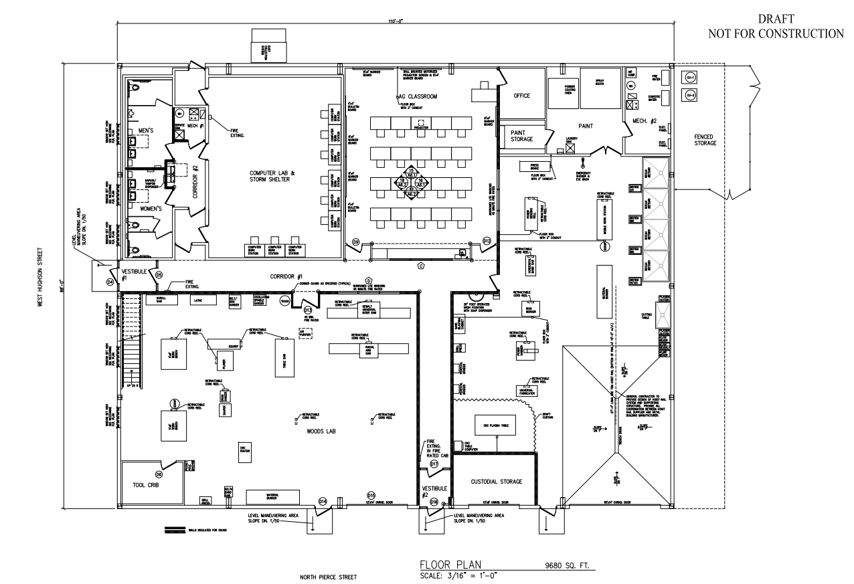
Career & Technical Education Building
Keep art room in JR/SHS
Smaller but still focused on function and needs

Slide 10
Middle/High School

Slide 11
Structural Repairs and Roofing
Objectives
Construction Solutions
Evaluation of structural damage around the chimney
Repair and replacement of decking, insulation, and roofing
Current leak where the lower roof abuts the original gymnasium
Investigation of potential mold/roof leak along west wall of north gymnasium
Replace all damaged decking
Install new sloped insulation system and EPDM roofing
Apply weather barrier to existing gymnasium brick wall
Install rain screen with proper flashings
TBD
Removed from bond.
Being completed this summer

Slide 12
HVAC and Air Conditioning
Objectives
Construction Solutions
Replace existing air handler units in mechanical room 208
Provide two new air handling units
  Reuse existing ductwork when possible
  New condensing units
Replace existing relief air fans
Replace damper actuators
Provide CO2 sensers
Upgrade controls
Provide electrical powers required
A/C and fans to be added to the new gym

Slide 13
Elementary School

Slide 14
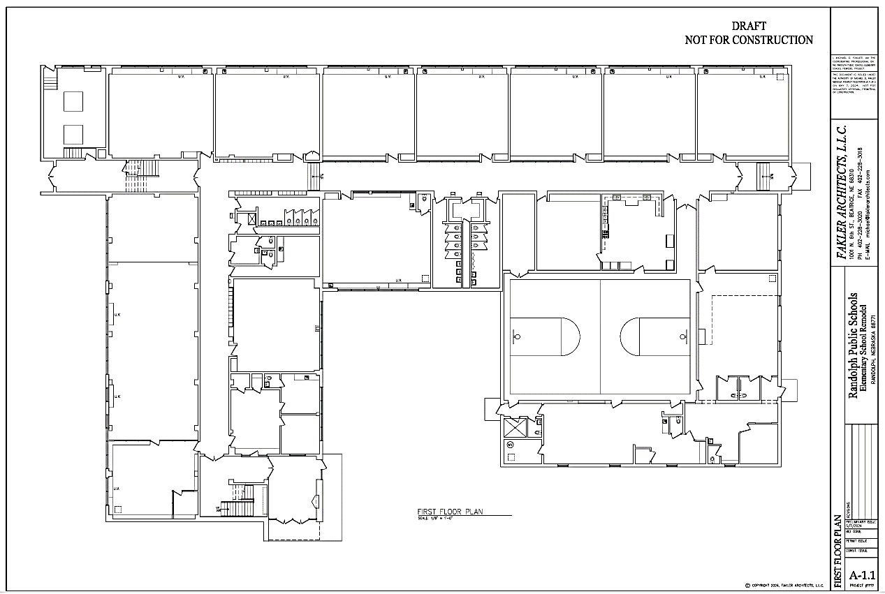

Slide 15
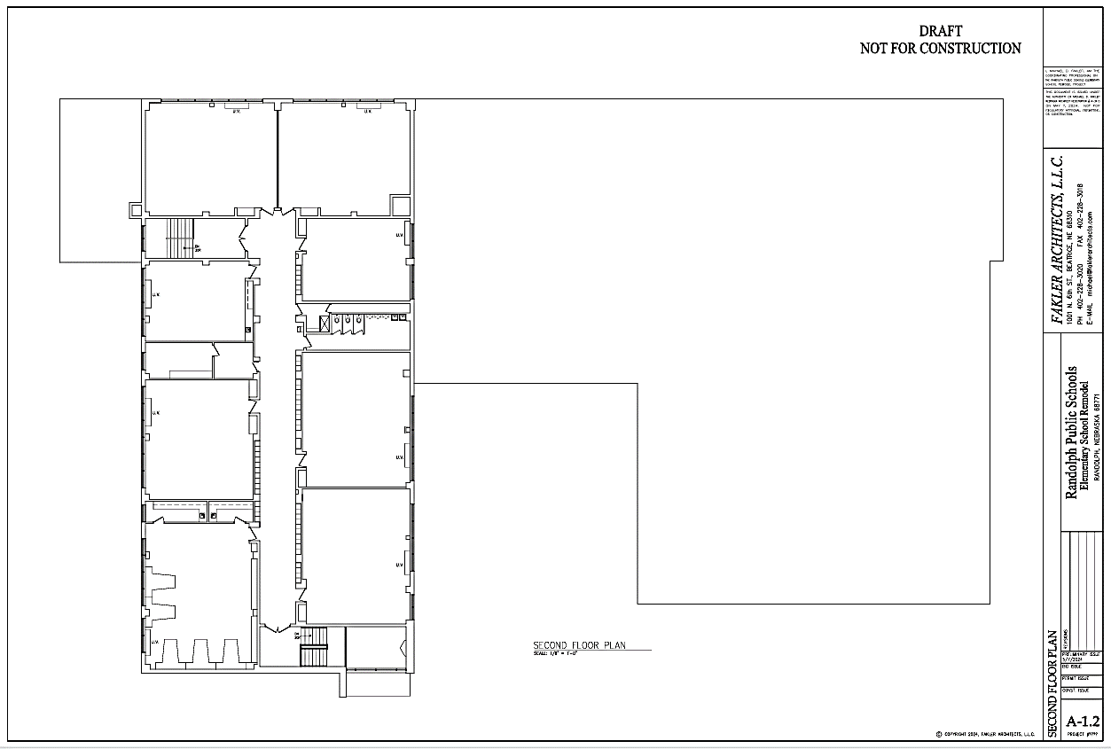

Slide 16
HVAC System Replacement
Objectives
Construction Solutions
Replace HVAC systems
Remove all existing equipment and materials
Install new ducted water-sourced heat pump units
  Option 1 – new boiler and chiller system
  Option 2 – geothermal well-field system
  Electrical service will be upgraded

Slide 17
Electrical Upgrades
objectives
Construction solutions
Add electrical outlets in classrooms
Provide eight surface-mounted receptacles and two new 20-amp circuits per classroom
In the library, provide 10 surface-mounted receptacles and two 20-amp circuits

Slide 18
Lighting Upgrades
objectives
Construction solutions
Replace existing fluorescent lighting with LED
Install new 2x2 recessed LED troffers
Provide classrooms and library with dimmer switches
Provide emergency battery back-up
Provide occupancy sensors

Slide 19
Fire Sprinklers
Objectives
Construction solutions
Add fire sprinklers to the building
Provide new 4-inch fire sprinkler service
  Include backflow preventer and required accessories
  Provide connection to fire alarm system as required

Slide 20
Corridor Ceilings
objectives
Construction solutions
Replace corridor ceilings
Remove existing corridor ceilings
Install new 2'x2' mineral fiber suspended ceiling tiles

Slide 21
Windows
objectives
Construction Solutions
Replace exterior windows
Replace all window with OPTIQ AA5450 series windows by Kawneer with 1 ½” triple glazed tempered glass

Slide 22
Restroom Renovations
objectives
Construction solutions
Add boys’ restroom on
1st floor
Demo existing girls’ north restroom and adjacent office uni-sex restrooms and janitor’s closet
Lay out new boys’ and girls’ restrooms
Provide all new fixtures and finishes
Create new janitor’s closet

Slide 23
Restroom Renovations, cont.
objectives
Construction solutions
Add girls’ restroom on 2nd floor
Utilize existing storage room east of existing boys’ restroom
Lay out new boys’ and girls’ restrooms
Provide all new fixtures and finishes
Create new janitor’s closet

Slide 24
Main Entrance Security
Objectives
Construction solutions
Improve security at main entrance
Replace borrowed-light window at principal’s and secretary’s office
Provide security pass-through at secretary’s window
Provide new security door to corridor
Provide steel bollards

Slide 25
Kitchen Addition
objectives
Construction solutions
Add serving kitchen in courtyard area north of gymnasium
Add slab-on-grade addition, approximately 900 sq. ft.
Utilize ICF structure with light-gage metal roof trusses
Addition will contain a kitchen with serving area that can double as table storage
Took kitchen staff on tours of similar approaches

Slide 26
Bond Project Cost Estimate
Total Estimated Cost: $9,000,000
Special Building Fund Contribution $250,000
Total Bond Amount $8,750,000

Slide 27
Financial Update
tax impact

Slide 28
Bond Information
Par Amount $8,750,000
Maturity Length 20 years
Preliminary Interest Rate 4.30%
Avg Annual Bond Payment $650,000
Bond Levy 9.5¢

Slide 29
Tax Impact
Property (per year) Ag Land (per acre/year)
$100,000 $95 Irrigated $4.86
$250,000 $238 Dry land $4.55
$500,000 $475 Grass $1.77
*Based upon highest per acre assessed value in the district per 2024 NE Dept of Revenue Report.

Slide 30
Timeline

Slide 31
New Bond Timeline
February 26, 2025 Community Meeting
March 10, 2025 BOE Election Resolution
March-May 2025 Public Bond Information
April 21, 2025 Ballots Mailed to Voters
May 13, 2025 Election Day

Slide 32
Questions & Answers

